Slide 1


Life at Hawkley!
Head of Year: Mrs Holland
Assistant Head of year: Miss Adamson
7H | M Hague
7A | D Jackson
7W | E Ollerton
7K | E Gibbon
7L | K Janvier
7E | S Cavanagh
7Y | B Fletcher
7S | E Eskersall
7C | L Nestor
Student Support Officer:
Mrs Collier

Slide 2
Some words from our current Y7s
James Y7 ‘I thought the school was really big to start with but I got used to it quickly and there is always someone to ask when you can’t find somewhere’
Connor Y7 ‘There are lots of things to do as well as lessons. I go to Inclusion and play games with my friends’
‘They are strict on uniform but as long as you are careful it is OK!’ Lucy Y7
Lily Y7 ‘The school is very friendly. My teachers always offer to help me when I need it’
Amelia Y7 ‘You get to do lots of subjects and try new things’

Slide 3
The Year 7 Team and their roles
Head of Year and Assistant Head of Year – Mrs Holland and Miss Adamson – behaviour and welfare
Form Tutors – in the first instance queries relating to settling in / organisation
Student Support Officer– Mrs Collier; admin and first aid
Inclusion – Mrs Holmes / Mrs Jackson
Safeguarding – Miss O’Brien / Mrs Serjent
Attendance officer – Mrs Serjent

Slide 4

How are form groups arranged?
Discussions with your primary schools
Gender split
Distribution of children of different abilities
Only a few (3) subjects taught in forms. You will be in different classes for all of the different subjects.
It’s a NEW START!
You WILL make new friends!
You WILL still talk to your primary school friends, but maybe not as often
There are 250 students in your year group
There WILL DEFINITELY be someone for you!

Slide 5


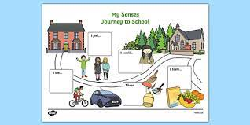
How can I get prepared for life at secondary school?
Buy an alarm clock. If you are late to school you will get a lates’ detention!
Always eat some breakfast, even if you feel nervous during the first week. It’s quite a wait until lunch.
Work out your route to school, whether you’re walking or taking public transport. Practise until you’re confident and time yourself. Also, make sure you have an alternative route in case of problems with transport or people you want to avoid. If it helps, draw a map.

Slide 6
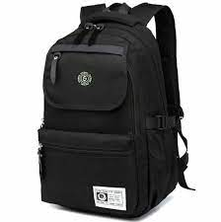
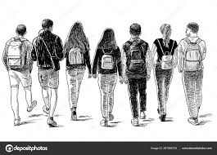



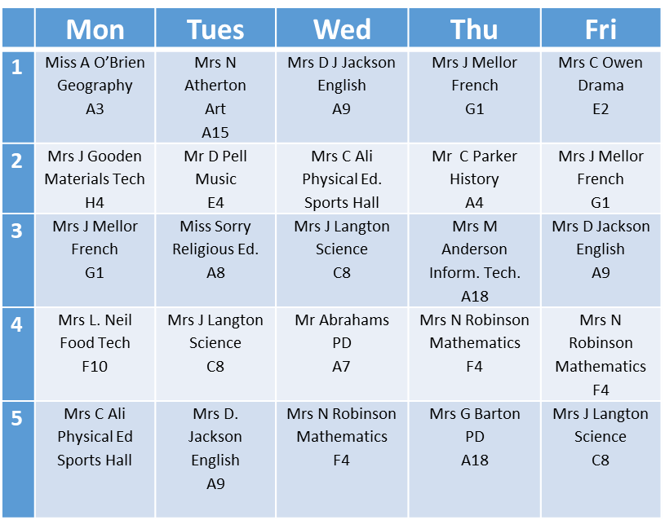
Buy a very big, very strong bag. You will have loads to carry. And that’s not counting the days when you’ll have your PE kit.
If you can, find a friend to walk with on your first day. Things won’t seem so daunting if you can travel with someone.
Be prepared to just ‘hang out’ at playtime. Don’t call it ‘playtime’ – it’s ‘break’ now.
Find out where the toilets are.
Make sure you turn your mobile phone off during school time.
When you are given your timetable, make at least three copies: one for your bag, one for your pocket and a spare for home.

Slide 7
Go through your timetable and pack your bag the night before – there’s never time in the morning to find your maths book.
Never be afraid to ask for help if you’re not sure where to go.
At lesson changeover, stick with someone who knows where they’re going. And don’t try to go against the flow of traffic. Keep to the left
Relax and try to enjoy it – in no time at all, it’ll seem like you’ve been here forever. And this time next year, you’ll be showing the new intake around the school.

Slide 8



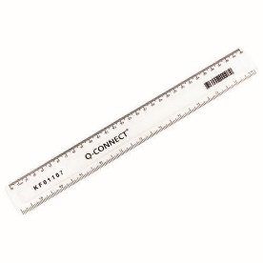
A typical day
First bell | 8.40 am
Engagement period | 8.45– 9.10 am
Period 1 | 9.10 – 10.10 am
Period 2 | 10.10 – 11.10 am
Break | 11.10 – 11.25 am
Period 3 | 11.25 – 12.25 pm
Lunch | 12.25 – 12.57 pm
First bell | 12.57 pm
Period 4 | 1.00 – 2.00 pm
Period 5 | 2.00 – 3.00 pm
 | Mon | Tues | Wed | Thu | Fri
1 | Miss A O’Brien Geography A3 | Mrs N Atherton Art A15 | Mrs D J Jackson English A9 | Mrs J Mellor French G1 | Mrs C Owen Drama E2
2 | Mrs J Gooden Materials Tech H4 | Mr D Pell Music E4 | Mrs C Ali Physical Ed. Sports Hall | Mr C Parker History A4 | Mrs J Mellor French G1
3 | Mrs J Mellor French G1 | Miss Sorry Religious Ed. A8 | Mrs J Langton Science C8 | Mrs M Anderson Inform. Tech. A18 | Mrs D Jackson English A9
4 | Mrs L. Neil Food Tech F10 | Mrs J Langton Science C8 | Mr Abrahams PD A7 | Mrs N Robinson Mathematics F4 | Mrs N Robinson Mathematics F4
5 | Mrs C Ali Physical Ed Sports Hall | Mrs D. Jackson English A9 | Mrs N Robinson Mathematics F4 | Mrs G Barton PD A18 | Mrs J Langton Science C8

Slide 9
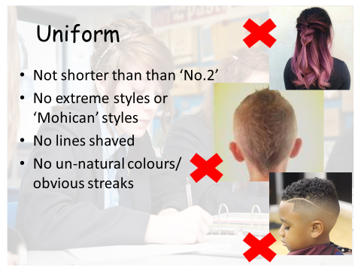
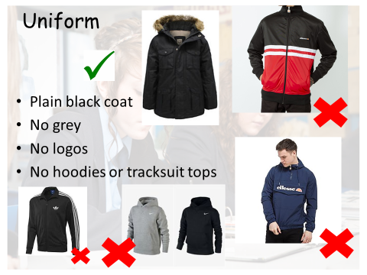
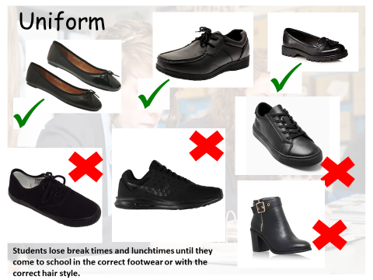
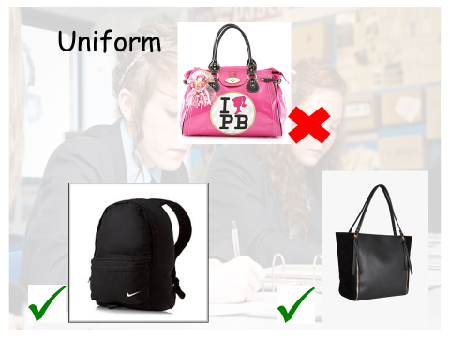
We pride ourselves in smart uniform. Uniform cards are carried by EVERY student in the school. 3 signatures on your card means you can not come to school in non-uniform on the last day of half-term

Slide 10

Most homework will be set on a system called Show My Homework – you and your parents/carers will be given a log in for this
A table/desk set aside at home for to complete your homework would be a good idea.
You will receive three formal academic reports per year. More information will be given on these in September

Slide 11
Typical worries for Year 7
Getting lost
Homework or classwork
Dinner time
Detentions
Friendships, falling out or bullying
Social media

Slide 12
Try something new and get involved!
Darts
Choir
Film club
Netball
Science club
Book club
Drama club
Cooking
Rock /pop band
Football club
Rugby
Art club

Slide 13




TRAVEL
However you travel, be through the gate by 8.38!

Slide 14



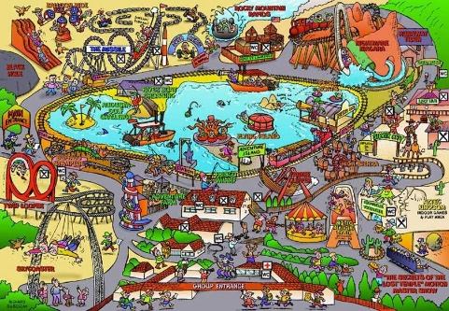

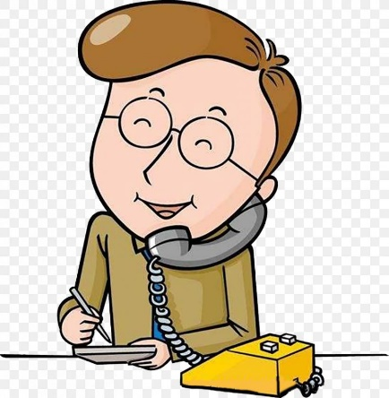

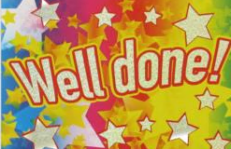


Slide 15


During the Covid pandemic and school closure, we have very successfully used Microsoft Teams to deliver online lessons to students. We will continue to use this in the new academic year, so where possible please try to familiarise yourselves with this over the summer break.

Slide 16
The Year 7 Team and their roles
Head of Year and Assistant Head of Year – Mrs Holland and Mrs Ali – behaviour and welfare
Form Tutors – in the first instance queries relating to settling in / organisation
Student Support Officers – Mrs Fulster and Mrs Mannion; admin and first aid
Inclusion – Mrs Holmes / Mrs Jackson
Safeguarding – Miss O’brien / Mrs Serjent
Attendance officer – Mrs Serjent
Unless it is an emergency, please avoid coming in to reception and asking to see a specific member of staff they are likely to be teaching or in meeting
Please ring ahead if possible
Leave a message with the office and someone will get back to you (may sometimes be after 3pm).
An emergency situation will obviously be treated differently.

Slide 17
