Slide 1
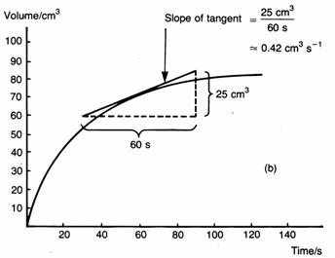
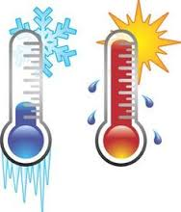
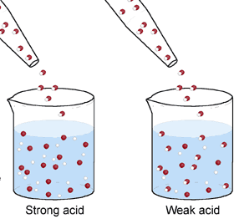
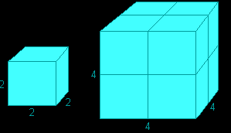
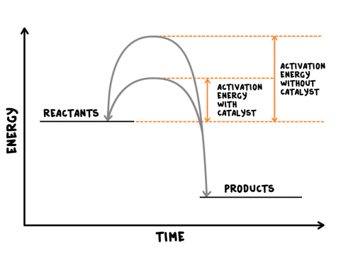
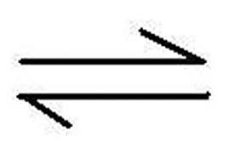
Rate of chemical reaction | This can be calculated by measuring the quantity of reactant used or product formed in a given time. | Rate = quantity of reactant used time taken Rate = quantity of product formed time taken
Factors affecting the rate of reaction
Temperature | The higher the temperature, the quicker the rate of reaction.
Concentration | The higher the concentration, the quicker the rate of reaction.
Surface area | The larger the surface area of a reactant solid, the quicker the rate of reaction.
Pressure (of gases) | When gases react, the higher the pressure upon them, the quicker the rate of reaction.
Quantity | Unit
Mass | Grams (g)
Volume | cm³
Rate of reaction | Grams per cm³ (g/cm³) HT: moles per second (mol/s)
Calculating rates of reactions
Factors affecting rates
Rate of reaction
Collision theory and activation energy
AQA GCSE
The rate and extent of chemical change
Catalyst | A catalyst changes the rate of a chemical reaction but is not used in the reaction.
Enzymes | These are biological catalysts.
How do they work? | Catalysts provide a different reaction pathway where reactants do not require as much energy to react when they collide.
Collision theory | Chemical reactions can only occur when reacting particles collide with each other with sufficient energy. | Increasing the temperature increases the frequency of collisions and makes the collisions more energetic, therefore increasing the rate of reaction. Increasing the concentration, pressure (gases) and surface area (solids) of reactions increases the frequency of collisions, therefore increasing the rate of reaction.
Activation energy | This is the minimum amount of energy colliding particles in a reaction need in order to react.
Catalysts
If a catalyst is used in a reaction, it is not shown in the word equation.
Reversible reactions and dynamic equilibrium
Reversible reactions
Reversible reactions | In some chemical reactions, the products can react again to re-form the reactants.
Representing reversible reactions | A + B C + D
The direction | The direction of reversible reactions can be changed by changing conditions: heat A + B C + D cool
Changing conditions and equilibrium (HT)
Le Chatelier’s Principles | States that when a system experiences a disturbance (change in condition), it will respond to restore a new equilibrium state.
Changing concentration | If the concentration of a reactant is increased, more products will be formed . If the concentration of a product is decreased, more reactants will react.
Changing temperature | If the temperature of a system at equilibrium is increased: Exothermic reaction = products decrease Endothermic reaction = products increase
Changing pressure (gaseous reactions) | For a gaseous system at equilibrium: Pressure increase = equilibrium position shifts to side of equation with smaller number of molecules. Pressure decrease = equilibrium position shifts to side of equation with larger number of molecules.
Equilibrium
The relative amounts of reactants and products at equilibrium depend on the conditions of the reaction.
Equilibrium in reversible reactions | When a reversible reaction occurs in apparatus which prevents the escape of reactants and products, equilibrium is reached when the forward and reverse reactions occur exactly at the same rate.
Energy changes and reversible reactions
If one direction of a reversible reaction is exothermic, the opposite direction is endothermic. The same amount of energy is transferred in each case.
For example: _{endothermic}
Hydrated copper Anhydrous copper + Water
sulfate ^{exothermic} sulfate

Slide 2
 | This can be calculated by measuring the quantity of reactant used or product formed in a given time. | Rate = quantity of reactant used time taken Rate = quantity of product formed time taken
Factors affecting the rate of reaction
 | The higher the temperature, the quicker the rate of reaction.
 | The higher the concentration, the quicker the rate of reaction.
 | The larger the surface area of a reactant solid, the quicker the rate of reaction.
 | When gases react, the higher the pressure upon them, the quicker the rate of reaction.
Quantity | Unit
Mass
Volume
Rate of reaction
Calculating rates of reactions
Factors affecting rates
Rate of reaction
Collision theory and activation energy
AQA GCSE
The rate and extent of chemical change
 | A catalyst changes the rate of a chemical reaction but is not used in the reaction.
 | These are biological catalysts.
 | Catalysts provide a different reaction pathway where reactants do not require as much energy to react when they collide.
 | Chemical reactions can only occur when reacting particles collide with each other with sufficient energy. | Increasing the temperature increases the frequency of collisions and makes the collisions more energetic, therefore increasing the rate of reaction. Increasing the concentration, pressure (gases) and surface area (solids) of reactions increases the frequency of collisions, therefore increasing the rate of reaction.
 | This is the minimum amount of energy colliding particles in a reaction need in order to react.
Catalysts
If a catalyst is used in a reaction, it is not shown in the word equation.
Reversible reactions and dynamic equilibrium
Reversible reactions
 | In some chemical reactions, the products can react again to re-form the reactants.
 | A + B C + D
 | The direction of reversible reactions can be changed by changing conditions: heat A + B C + D cool
Changing conditions and equilibrium (HT)
 | States that when a system experiences a disturbance (change in condition), it will respond to restore a new equilibrium state.
 | If the concentration of a reactant is increased, more products will be formed . If the concentration of a product is decreased, more reactants will react.
 | If the temperature of a system at equilibrium is increased: Exothermic reaction = products decrease Endothermic reaction = products increase
 | For a gaseous system at equilibrium: Pressure increase = equilibrium position shifts to side of equation with smaller number of molecules. Pressure decrease = equilibrium position shifts to side of equation with larger number of molecules.
Equilibrium
The relative amounts of reactants and products at equilibrium depend on the conditions of the reaction.
 | When a reversible reaction occurs in apparatus which prevents the escape of reactants and products, equilibrium is reached when the forward and reverse reactions occur exactly at the same rate.
Energy changes and reversible reactions
If one direction of a reversible reaction is exothermic, the opposite direction is endothermic. The same amount of energy is transferred in each case.
For example: _{endothermic}
Hydrated copper Anhydrous copper + Water
sulfate ^{exothermic} sulfate

Slide 3
Rate of chemical reaction |  | Rate = quantity of reactant used time taken Rate = quantity of product formed time taken
Factors affecting the rate of reaction
Temperature
Concentration
Surface area
Pressure (of gases)
Quantity | Unit
 | Grams (g)
 | cm³
 | Grams per cm³ (g/cm³) HT: moles per second (mol/s)
Calculating rates of reactions
Factors affecting rates
Rate of reaction
Collision theory and activation energy
AQA GCSE
The rate and extent of chemical change
Catalyst
Enzymes
How do they work?
Collision theory |  | Increasing the temperature increases the frequency of collisions and makes the collisions more energetic, therefore increasing the rate of reaction. Increasing the concentration, pressure (gases) and surface area (solids) of reactions increases the frequency of collisions, therefore increasing the rate of reaction.
Activation energy
Catalysts
If a catalyst is used in a reaction, it is not shown in the word equation.
Reversible reactions and dynamic equilibrium
Reversible reactions
Reversible reactions
Representing reversible reactions
The direction | The direction of reversible reactions can be changed by changing conditions: heat A + B C + D cool
Changing conditions and equilibrium (HT)
Le Chatelier’s Principles
Changing concentration
Changing temperature
Changing pressure (gaseous reactions)
Equilibrium
The relative amounts of reactants and products at equilibrium depend on the conditions of the reaction.
Equilibrium in reversible reactions | When a reversible reaction occurs in apparatus which prevents the escape of reactants and products, equilibrium is reached when the forward and reverse reactions occur exactly at the same rate.
Energy changes and reversible reactions
If one direction of a reversible reaction is exothermic, the opposite direction is endothermic. The same amount of energy is transferred in each case.
For example: _{endothermic}
Hydrated copper Anhydrous copper + Water
sulfate ^{exothermic} sulfate

Slide 4
Rate of chemical reaction |  | Equation:
Factors affecting the rate of reaction
Quantity | Unit
 | Grams (g)
 | cm³
 | Grams per cm³ (g/cm³) HT: moles per second (mol/s)
Calculating rates of reactions
Factors affecting rates
Rate of reaction
Collision theory and activation energy
AQA GCSE
The rate and extent of chemical change
Catalyst
Enzymes
How do they work?
Collision theory
Activation energy
Catalysts
If a catalyst is used in a reaction, it is not shown in the word equation.
Reversible reactions and dynamic equilibrium
Reversible reactions
Reversible reactions
Representing reversible reactions
The direction
Changing conditions and equilibrium (HT)
Le Chatelier’s Principles
Equilibrium
The relative amounts of reactants and products at equilibrium depend on the conditions of the reaction.
Equilibrium in reversible reactions
Energy changes and reversible reactions
If one direction of a reversible reaction is exothermic, the opposite direction is endothermic. The same amount of energy is transferred in each case.
For example: _{endothermic}
Hydrated copper Anhydrous copper + Water
sulfate ^{exothermic} sulfate

