Slide 1
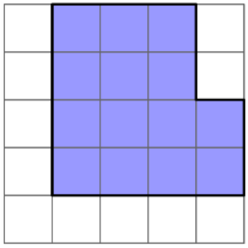
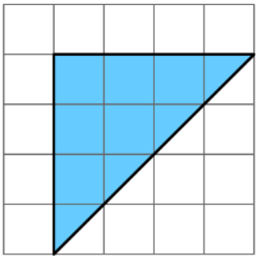
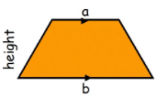
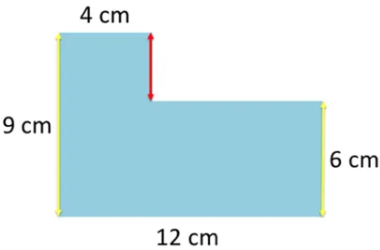

KEY VOCAB
KEY KNOWLEDGE
Perimeter is the distance measured around a 2D shape. You add to reach your answer.
Area is the space measured inside a 2D shape. You multiply to reach your answer.
Compound shapes are made up of two or more 2D shapes (for example, an ‘L’ shape is made up of two rectangles).
Regular shapes have equal sides and all the inside angles are equal.
Irregular shapes do not have equal sides or equal angles.
Area of a rectangle Area of a triangle
Calculating the area by counting squares
MATHS
Y7 Area &
Perimeter
Area of a trapezium Area of a parallelogram
Remember! Only count how many full squares have been covered.
Area = 14${cm}^{2}$
Area = 8${cm}^{2}$
Calculating the perimeter of a compound shape.
Area can be measured in…
${cm}^{2} m^{2} {mm}^{2} {km}^{2}$ and so on.
Perimeter can be measured in…
$cm m mm km$and so on.
Length Conversions
1 cm = 10 mm
1 m = 100 cm
1 km = 1000 m
1 mile = 1.6 km
Step 1: Add in any missing measurements.
9cm – 6cm = 3cm
12cm – 4cm = 8cm
Step 2: Add the distance around the shape.
4cm + 3cm + 8cm + 6cm
+ 12cm + 9cm = 42cm
3 cm
8 cm
FURTHER READING
https://www.bbc.co.uk/bitesize/topics/zrf3cdm
https://corbettmaths.com/contents/
https://www.pearsonactivelearn.com/app/library
Perimeter = 42cm

