Slide 1
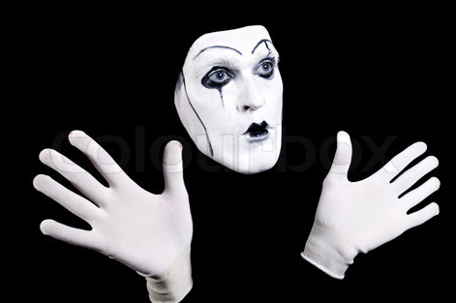
KEY KNOWLEDGE
The objective of this scheme of work is to develop your knowledge of Mime. The expected outcomes are:
You understand how to perform in the style of mime
You are able to utilise key physical skills to mime successfully
You develop your characterisation and comedy skills.
Year 8
DRAMA
Mime
FURTHER READING
Research slapstick comedy
Watch some examples of slapstick/mime performers. E.g. Mr Bean, Laurel and Hardy, and Jim Carey.
Body Language
Exaggeration
Key Skills of Mime
Tension
Precision
Facial Expression
Gesture
What is a stereotype?
__________________________
_______________________
_______________________
_______________________
KEY VOCABULARY
Mime | Slapstick | Comedy | Stereotype | Blocking
Physical Skills | Choral Movement | Silent Movie | Characterisation | Music

Slide 2
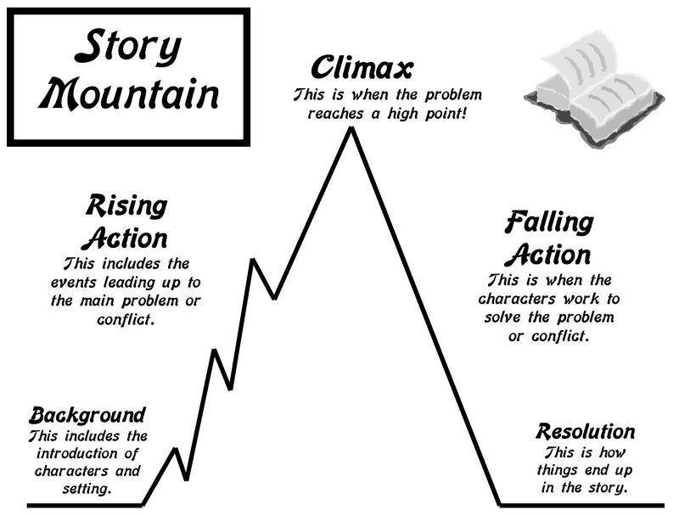
KEY KNOWLEDGE
The objective of this scheme of work is to develop your knowledge of devising theatre. The expected outcomes are:
You understand what devising means
Develop your knowledge of the skills and techniques used by actors and theatre companies to devise a piece of theatre
You are able to successfully develop an idea from a stimulus
Improve your creative thinking, story-telling and evaluative skills.
Year 8
DRAMA
Devising
FURTHER READING
Research the following theatre companies who specialise in Devising theatre: Kneehigh, The Paper Birds, Gecko, Complicate.
Why might you use cross-cutting in a piece of devised theatre?
_______________________
_______________________
_______________________
KEY VOCABULARY
Devising | Stimulus | Techniques | Symbolism
Cannon | Choral Movement | Cross-Cutting | Thought Track
Unison | Choral Speech | Hot Seating | Mirroring

Slide 3
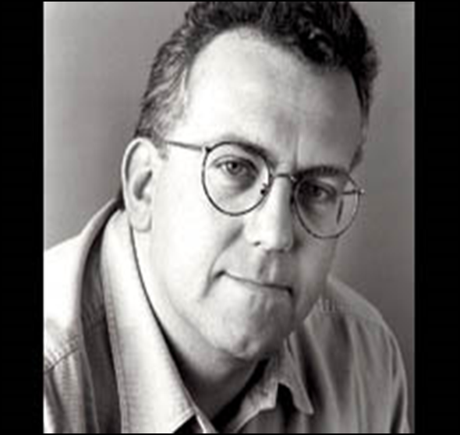
KEY KNOWLEDGE
The objective of this scheme of work is to develop your knowledge of John Godber’s style of theatre. You will also explore this style practically.
The expected outcomes are:
You understand the key features of Godber’s style
You are able to perform successfully in the style of Godber’s plays
You develop your characterisation, multirole and comedy skills.
Actors rarely leave the stage
Year 8
DRAMA
John Godber
FURTHER READING
Research some of John Godber’s plays, some examples are:
Bouncers
Shakers
Teechers
Up and Under
Minimal set/props
Short Scenes
Features of Godber’s style
Fast pace
Comedic, stereotypical, usually working class characters
What physical and vocal skills can we use to create a stereotypical character?
_______________________
_______________________
_______________________
KEY VOCABULARY
Multirole | Fast Pace | Comedy | Lighting | Music
Face out the Drama | Choral Movement | Choral Speaking | Stereotypes | Transitions

Slide 4
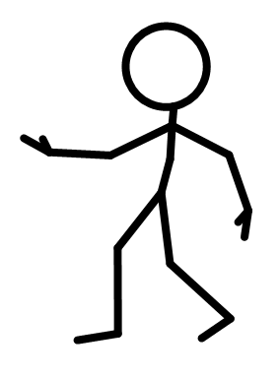
KEY KNOWLEDGE
The objective of this scheme of work is to develop your knowledge of monologues and duologues. The expected outcomes are:
You understand what monologues and a duologues are
You develop your knowledge of the acting skills needed to rehearse and successfully perform a monologue and a duologue
Improve your understanding of the elements of script work.
“Mono” (one)
+ “-logue” (dialogue/speech)
= one person speech
“Duo” (two)
+ “-logue” (dialogue/speech)
= two people speaking
Year 8
DRAMA
Monologues and Duologues
FURTHER READING
Tips for performing a successful monologue → https://www.spotlight.com/news-and-advice/tips-and-advice/tips-for-performing-your-best-monologue/
Can you think of any monologues or duologues from films you have seen?
_______________________
_______________________
_______________________
KEY VOCABULARY
Monologue | Script work | Rehearsal | Blocking | Staging
Duologue | Acting Skills | Physical | Vocal | Directing

Slide 5
KEY KNOWLEDGE
The objective of this scheme of work is to develop your knowledge of
Year 8
DRAMA
The Island
FURTHER READING
_______________________
_______________________
_______________________
KEY VOCABULARY
Devise | Character | Flashback | Multirole | Script
Still Image | Thought Track | Drama Techniques | Essence Machine | Proxemics

