Slide 1
Year 11 Parents Information Evening
February 2022

Slide 2
Summer 2022 Adaptations to the GCSE and Vocational Exams

Slide 3
Summer 2022 GCSE/
Vocational Examinations latest information
The government and the Department of Education last week reiterated that the summer 2022 examination season will go ahead unless...
"a national emergency prevents students from physically sitting the examinations"

Slide 4
The examinations will run over a five-week period. The papers per subject have been spaced out to allow students to sit the examinations for all their subjects even if they miss one (or a few) due to COVID.
For Hawkley Hall students the examinations start on Thursday 12th May 2022 and run until Monday 27th June with the last full cohort examination being Thursday 23rd June.

Slide 5
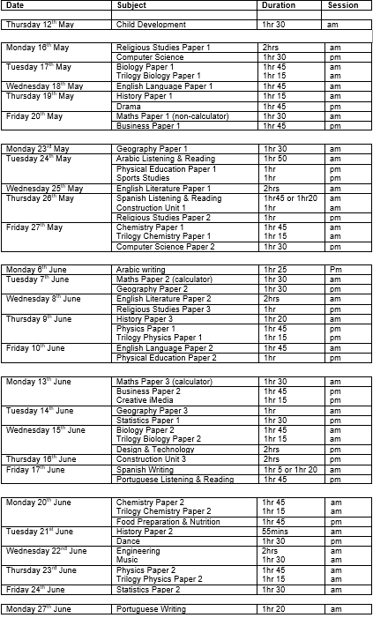
The GCSE/Vocational
Summer 2022 timetable

Slide 6
Dear students,
In my job as Chief Regulator of qualifications I get to meet many students, teachers and parents from different parts of the country. Speaking to students like you, who are getting ready for formal exams and assessments, it’s clear to me that you want life to get back to normal and that you would like as much certainty about what is going to happen as possible.
For that reason, the exam boards have, this week, published for you ‘advance information’ on their websites. This is subject by subject, specification by specification, specific outlines of the focus of questions across many of your summer exams.
We’ve added a tool on our website which shows you what is available for each subject.
These materials are just one of the ways we are working to make sure that, despite the disruption caused by the coronavirus (COVID-19) pandemic, your exams and formal assessments are less daunting.
You will also get formulae sheets for GCSE maths exams and updated equation sheets for GCSE physics and combined science exams, so you won’t have to memorise as much.
As well as advance information and formulae sheets, you will be supported by generous grading, which will provide you with a safety-net to protect you from just missing out on a grade.
We will also publish videos, infographics and other materials to help those of you who have been prevented from ever sitting a formal exam, to know what that feels like.
You can find more information at the following official sources:
Rolling update
Ofqual Instagram
Ofqual blog
Best wishes,
Dr Jo Saxton Ofqual Chief Regulator

Slide 7
The Advanced Information for subjects from the examination boards was released last week and this has been sent out. It has also been collated on this JCQ link...
https://www.jcq.org.uk/summer-2022-arrangements/advance-information/
There is also useful information on the following link as referenced on the previous slide...
https://www.gov.uk/guidance/subject-by-subject-support-for-gcse-as-and-a-level-students-in-2022?utm_source=letter_to_schools_colleges_7_feb_2022&utm_medium=email&utm_campaign=advance_information

Slide 8
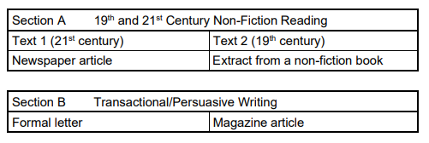
To summarise the main points for the core subjects are as follows...
English Language

Slide 9
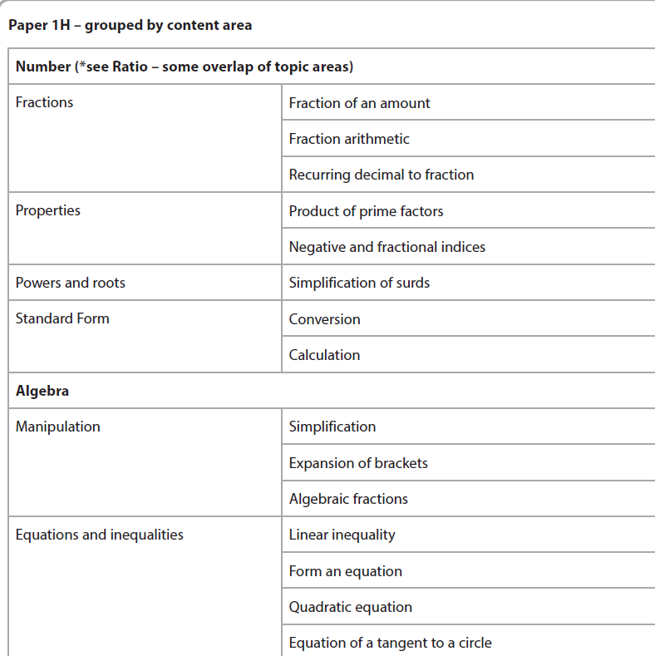
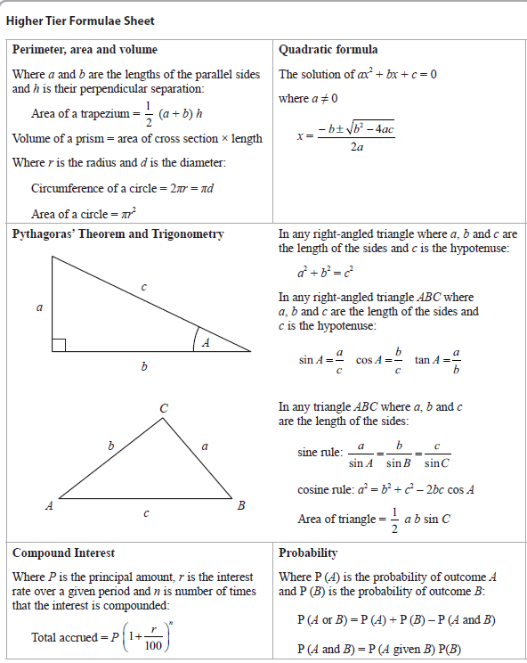
Mathematics
Information regarding the topics areas to
be assessed for each paper.
An exam aid with the relevant formulae will also be provided.

Slide 10
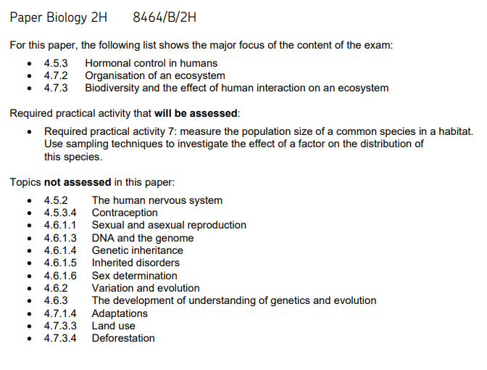
Trilogy Science: the information has been broken down into biology, chemistry and physics. An example of the biology advanced information is as follows…

Slide 11
Revision Techniques and Exam Preparation
2022
Notes:
Read through the quote with your class – emphasise the greatness of Muhammad Ali and the sacrifices needed in order to gain reward.

Slide 12
How to revise for GCSE – A key resource

Slide 13
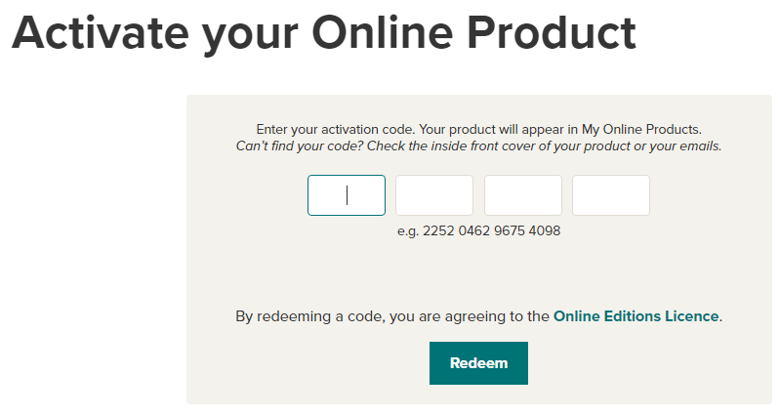
Also available online to be viewed on a device

Slide 15
GCSEPOD

Slide 18
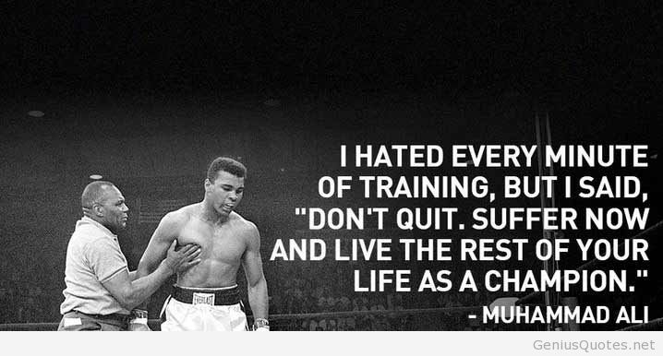
Revision might not be your most favourite thing in the world…
But if you put the effort in, you will reap the rewards for the rest of your life.
Notes:
Read through the quote with your class – emphasise the greatness of Muhammad Ali and the sacrifices needed in order to gain reward.

Slide 19
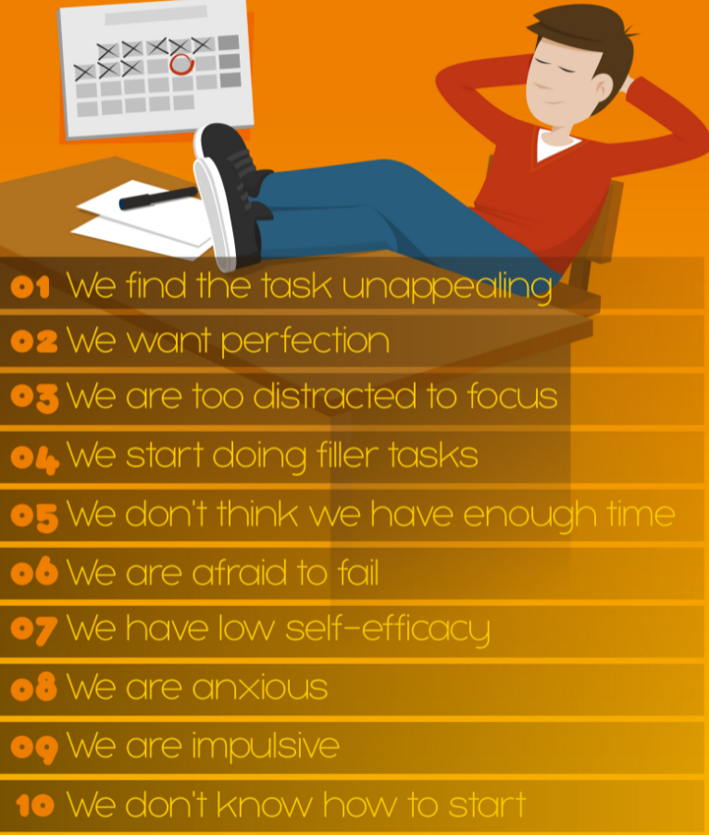
Procrastination
10 things that can end in procrastination

Slide 21
How Does Spaced Repetition Work? While repetition is essential for remembering what one has learned, the amount of information that the human brain can absorb falls quickly over time. This is known in psychology as the Ebbinghaus Forgetting Curve

Slide 22
Review your learning after……
A day
A week
A month
Just before the exam
You will remember more! I promise.
Hermann Ebbinghaus
1850-1909

Slide 23
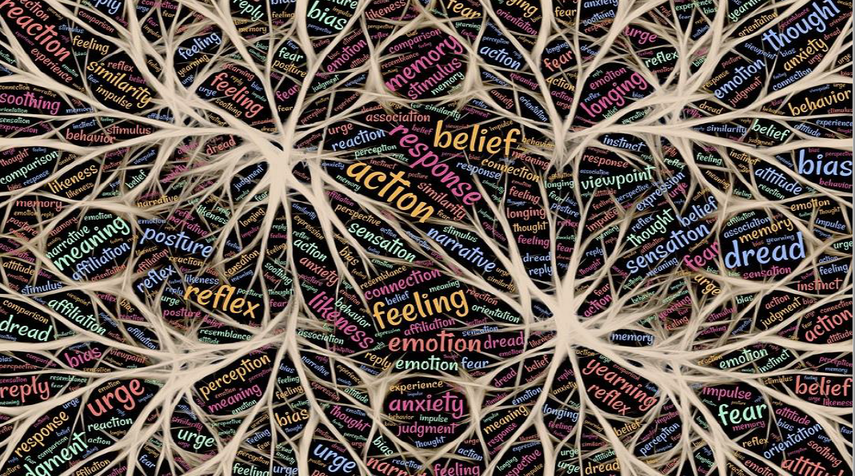
Revision is critical to help the brain create ‘schema’ linking knowledge and committing it to long term memory
Notes:
Worth highlighting the ‘science’ behind the idea of committing knowledge to memory. In this case remind students that the brain is a muscle and memory can be developed. Practice makes perfect so to speak.

Slide 26
A piece of text on Muhammad Ali…
About/Personal: Cassius Clay was born on the 17th of January 1942 in Louisville, Kentucky. In his personal life he has been married four times. He has two daughters and seven sons. In 1964 he became a Muslim and changed his name to Muhammad Ali.
Career: He first started boxing as a boy as he had his bike stolen and he wanted to resist bullies so he joined a boxing gym. At first he was an amateur boxer but turned professional in 1960, pausing for four years before restarting his career in 1971.
Style: He was a stylish fighter known for his fast hands and dancing style. He often talked to opponents, taunting them during fights. He was also known for his sense of humour. He would predict when his fights would end using phrases like ‘to prove I am great he will fall in eight’
Controversies: Ali was a controversial figure. For example, after becoming a Muslim he joined the Nation of Islam. He was completely against American involvement in the Vietnam War and he refused to fight. As a result he was stripped of his titles.
Greatness: Undoubtedly he was a phenomenon. He won Olympic Gold in 1960. As a professional he had 56 wins including 37 knockouts. He only lost 5. Unbelievably, he can came back to win the Heavyweight championship 3 times. In 1999 he was awarded the BBC award for the Sports Personality of the 20th century and in 2005 he was given the US highest civilian award, the Medal of Honour.

Slide 28
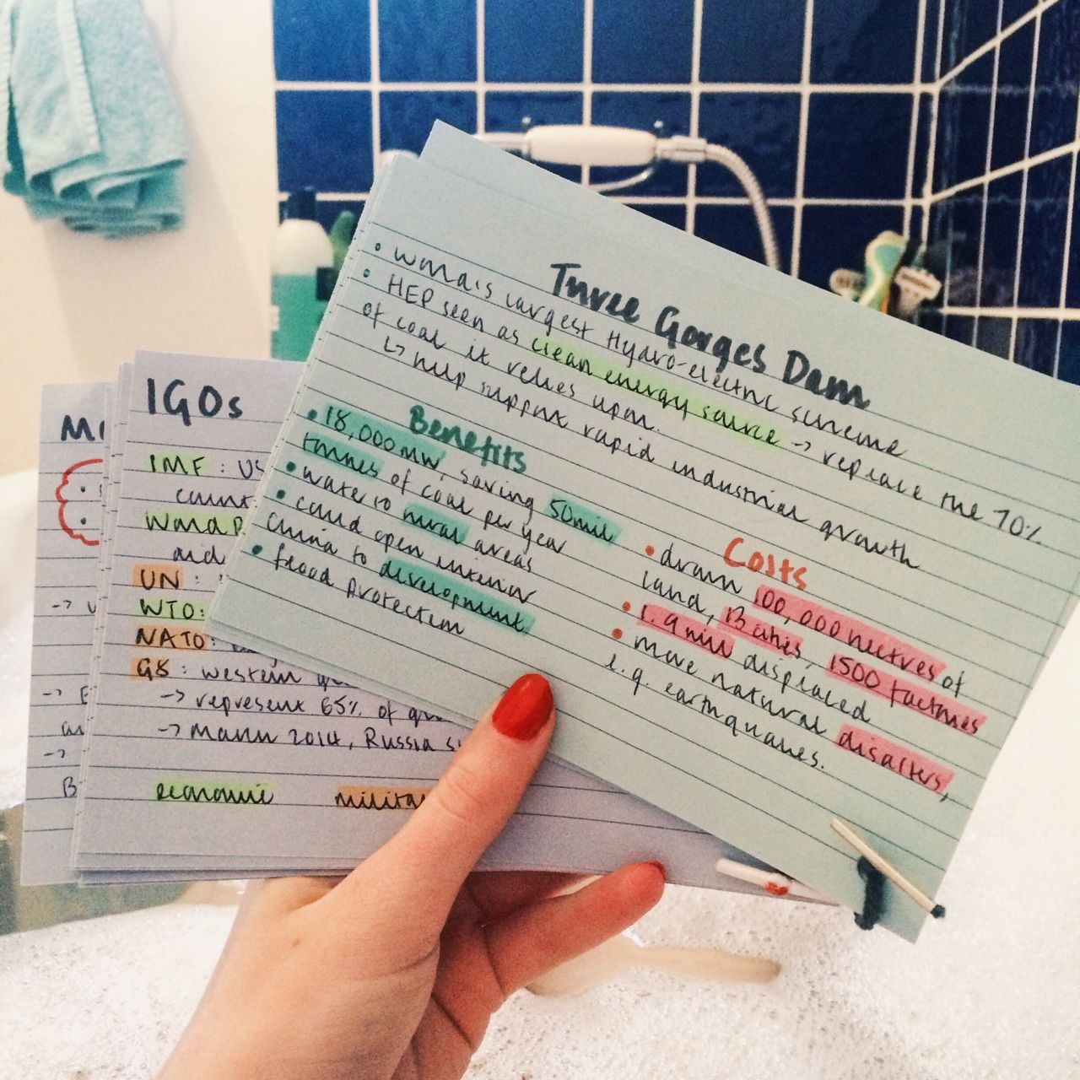
Index Cards
Excellent for working through and then condensing work – Crucial that students colour, highlighters and symbols to help organise their cards. They may put questions on one side and knowledge on the other.
Notes:
Explain that we will be providing a subsidised pack for you and then selling them to you cheaply via Parentmail for collection.

Slide 29
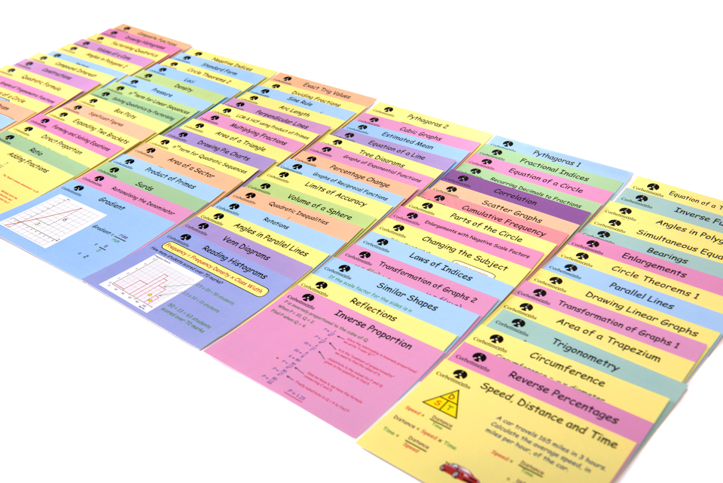
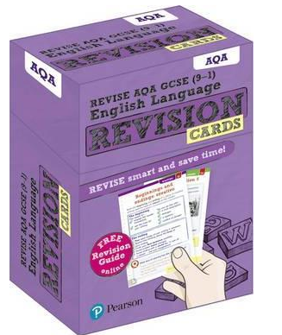
Revision Cards – Available to buy

Slide 31
Note Creation: BRAIN FRAMING
When creating revision materials try to think of the following tips:
Ask yourself questions (Why? What? Where? When? How? Who?)
Use colours
Add Borders to notes.
List (use BULLET POINTS)
Highlight key words.
For ideas use pictures!
Develop your own code
K = Key point
L = Look back later
? = I don’t get this. Ask someone
= I know this

Slide 32
Think you have learned a topic? It is good to test yourself in a creative way.
Once you have learnt a topic, try to write down something about it. Try to write down one thing about it next to each letter.
Remember, you remember far more by trying to think of something for every letter.
Notes:
An alternative to this is an acrostic that could be used on a topic.

Slide 33
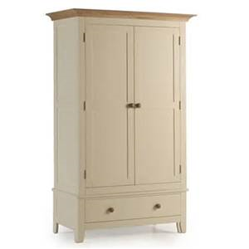
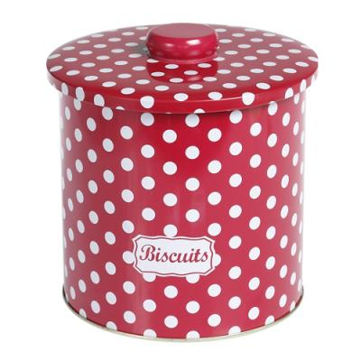
WHAT DO THE FOLLOWING HAVE IN COMMON?
Notes:
Pose this question to students – take responses.

Slide 34
They are all an ideal place to put sticky notes
Write or draw things on sticky notes and then put them where you’ll see them. Seeing them day in day out will help you REMEMBER.
Notes:
Advise students that recall and repetition is key in revision – constantly seeing prompts (even just key words etc) will make a massive difference.

Slide 35
Revision notes Some students may benefit from displaying summaries in a prominent place, forcing them to review key information

Slide 36
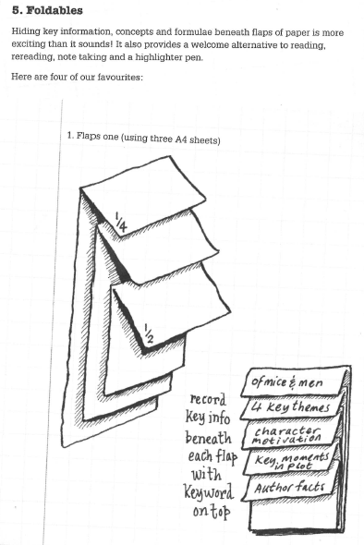
Foldables
Hiding key information, concepts and formulae beneath flaps of paper is more interesting than it sounds. It also provides a welcome alternative to reading, rereading, note taking and a highlighter pen
Notes:
**IF SUITABLE FOR YOUR GROUP**

Slide 37
Ever decreasing circles (or squares)
Notes:
**IF SUITABLE FOR YOUR GROUP** - Circles decrease in size in order to show learning being condensed; the first circle/box will contain lots of information – this will then reduce to the second – and will eventually boil down to a couple of key words (prompts) – helps you condense information.

Slide 38
Know what you are being tested on

Slide 39
Make the most of practice papers

Slide 40
Organisation and Planning

Slide 41
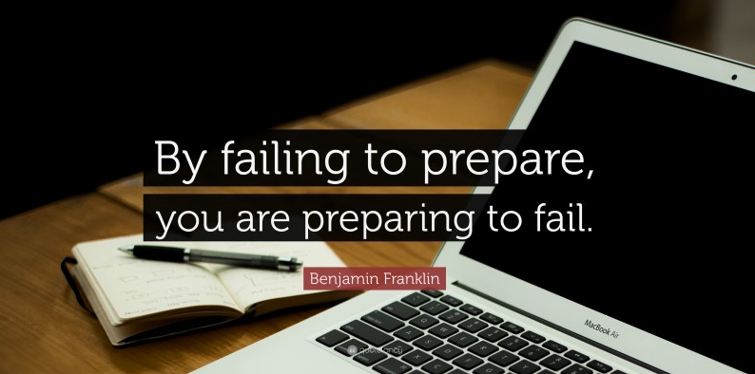
Planning your revision

Slide 43
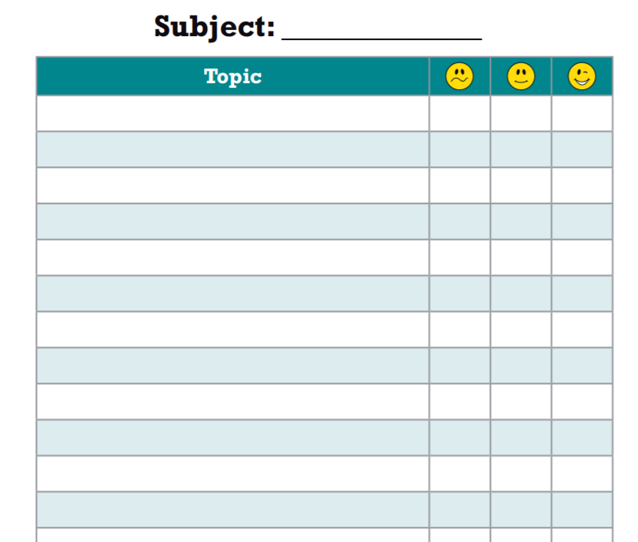

Slide 45
Supporting your child’s
mental health and wellbeing

Slide 46
Everyday Vs Overwhelming Feelings
Everyday – come and go and are a normal reaction to what is happening in our lives. They are always changing and don’t usually hang around for long
Overwhelming – hang around for a long time, change the way we feel and behave and may stop us from doing what we want in our life. You might hear people call them a Mental Health problem, illness or disorder.
Everyday
Overwhelming Feelings

Slide 47
Mental Health
https://www.youtube.com/watch?v=DxIDKZHW3-E
Notes:
Up to 1.40

Slide 48
Worry is a normal part of child development

Slide 49
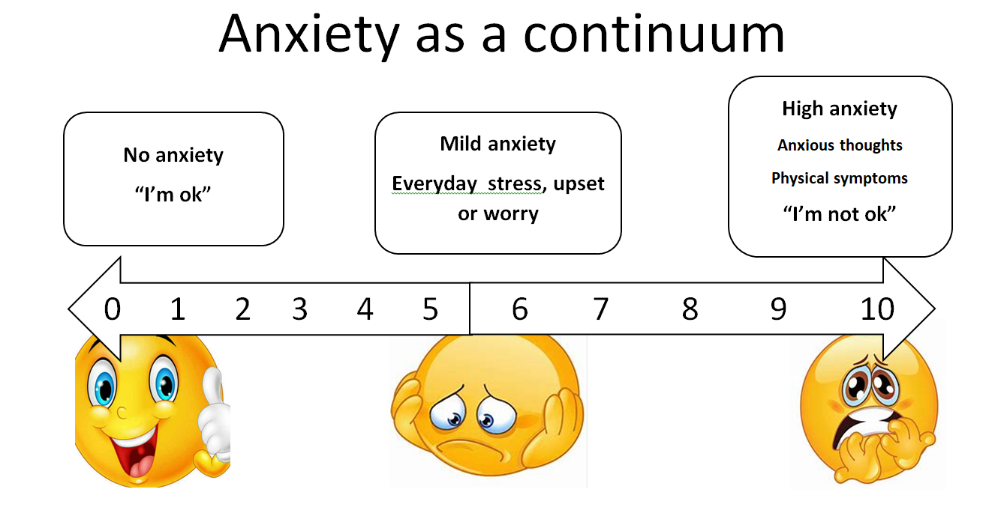
Anxiety explained
Children with anxiety disorders tend to have more intense worries. Anxiety is caused by our perception of threat. Anxiety put simply is the overestimation a perceived threat and underestimation our ability to cope.

Slide 50
Impacting factors – Social, Biological and Psychological
Adverse Childhood Experiences (ACE)
Social media
Pressure
School
Environmental
Resilience
Physical health
Friendships
Trauma

Slide 51
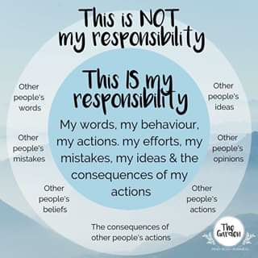
Notes:
Up to 1.40

Slide 52
Impact of exams on our mental health

Slide 53
Top tips to help with exam stress
Encourage your child to take care of themselves by eating the right kind of foods, drinking water and getting enough sleep. For teenagers 8 – 10 hours sleep is essential as tiredness can impair concentration and increase anxiety.
Provide reassurance by reminding your child of past/current successes and give giving them the opportunity to say how they are feeling.
Support them to develop a realistic revision timetable and encourage them to take regular breaks.
Promote regular exercise to get rid of physical tension. Improved blood flow to the brain can improve a young persons ability to think clearly, learn, concentrate and remember.
Encourage relaxation techniques such as controlled breathing and mindfulness.

Slide 54
Parent ‘GCSES’ during Year 10/11
Good enough relationships at home
Chill out time
Success reminders
Encourage effort and exercise
Sleep

Slide 55
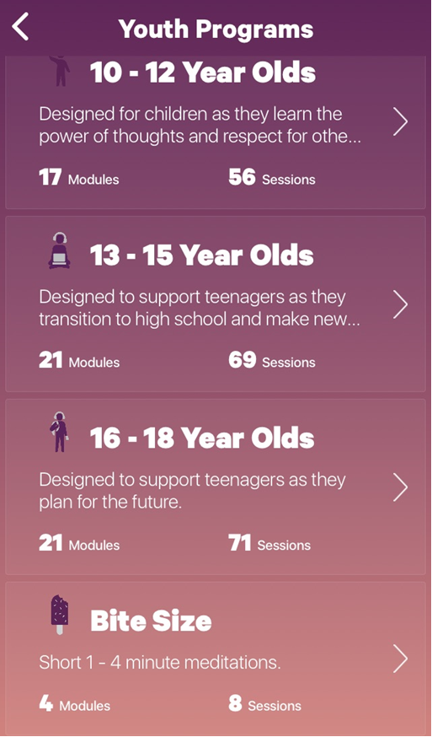
Helpful apps – Mindfulness

Slide 56
Helpful apps – Mindfulness
Smiling Mind
https://www.smilingmind.com.au/smiling-mind-app
3 Good Things

Slide 57
Helpful apps – Anxiety
Mindshift
https://youth.anxietycanada.com/

Slide 58
Helpful apps – Anxiety
https://www.clearfear.co.uk/
The Clear Fear app provides ways for children and young people to manage symptoms of anxiety. Clear Fear uses a Cognitive Behavioural Therapy (CBT) framework to help change anxious thoughts and emotions, alter anxious behaviours and calm fear responses.
It has helpful descriptions of the different ways in which anxiety shows, resources and a ‘grit box’ to boost resilience.
Clear Fear is recommended for the ages of 11-19 years.
It is not a substitute for a mental health professional.

Slide 59
Helpful websites
https://www.annafreud.org/selfcare/
https://youth.anxietycanada.com/

