Slide 1
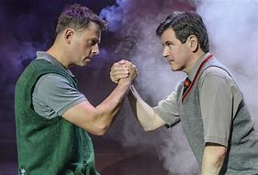
KEY KNOWLEDGE
Component 1 of the AQA Drama exam is worth 40% of your overall GCSE. The content for this will be studied throughout Year 10 and Year 11, and you will sit the exam in May of Year 11. There are 3 sections to the exam:
Section A: Roles and Responsibilities
4 multiple choice questions about roles within the theatre and various stage types
(5 minutes in exam)
Section B: Blood Brothers
Q6.1 (4 marks) – Describe how you would design the set, costume, or lighting at a certain point in the play.
Q6.2 (8 marks) – 1 line of text. Explain how would you use theatrical skills to perform as the character.
Q6.3 (12 marks) – Extract of text. Explain how would you use theatrical skills and proxemics to show the effect stated?
Q6.4 (20 marks) Whole page of text. How would you use your theatrical skills and proxemics to perform a character, link to other moments in the play.
(60 minutes in exam)
Section C: Billy Elliot
A 32-mark question, asking you to describe, analyse and evaluate an actor's theatrical skills in a live performance.
(40 minutes in exam)
KEY VOCABULARY
KS4 DRAMA
KVO:
Component 1
FURTHER READING/SUPPORT
Watch “Billy Elliot Live” (the filmed version of the stage show – NOT the film) at home. You can buy the DVD or purchase it on Amazon Prime for £3.99 →
Utilise the GCSE drama revision guides that we have provided! They have information on all sections of the Component 1 exam, including mark schemes and examples answers.
Physical Skills | Vocal Skills | Theatrical Skills
Blocking | Relationship | Levels
Genre | Style | Social, Historical & Political Context
Dramatic Intent | Effect | Convey
Evaluate | Analyse | Describe
Review | Proxemics | Explain

