Slide 1
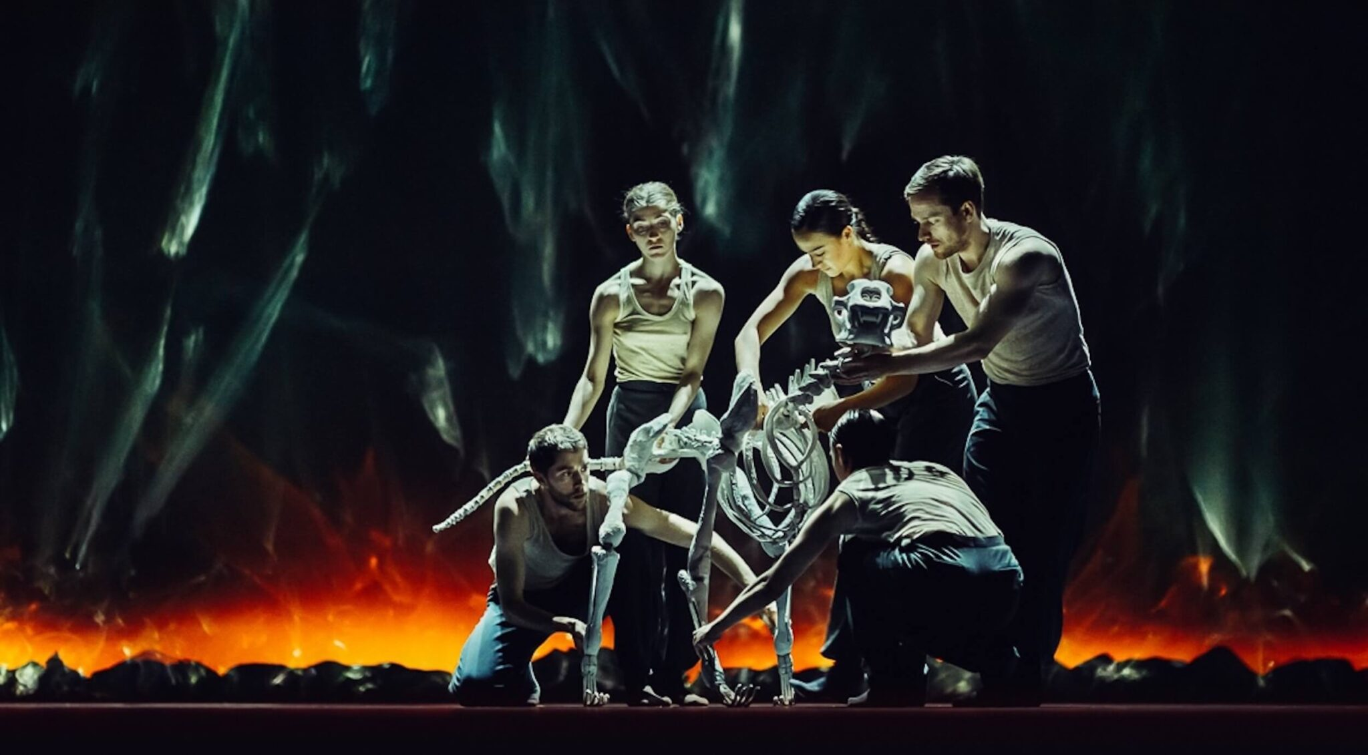
KEY KNOWLEDGE
Characteristics of performances
genre • structure • character • form • style • language • sub-text • character motivation and interaction • the creation of mood and atmosphere • the development of pace and rhythm • dramatic climax • stage directions
Social, cultural and historical contexts
the social, cultural and historical context in which the performance is set.
How meaning is interpreted and communicated
performance conventions • use of performance space and spatial relationships on stage • actor and audience configuration • relationships between performers and audience performers' vocal interpretation of character such as accent, volume, pitch, timing, pace, intonation, phrasing, emotional range, delivery of lines • performers' physical interpretation of character such as build, age, height, facial features, movement, posture, gesture, facial expression.
Devising Log: 60 marks
Devising Performance: 20 marks
AQA GCSE
DRAMA
COMPONENT 2 (40%)
Devising Drama
CHALLENGE TASK
Look through these websites that will help you with devising ideas.
https://www.franticassembly.co.uk/
https://www.thepaperbirds.com/
https://www.complicite.org/
What do you like about these companies approaches to devising?
Section 1: Response to a stimulus • Section 2: Development and collaboration • Section 3: Analysis and evaluation.
2,500 words
LOG BOOKS
https://www.youtube.com/watch?v=Q4mXhW7TXQ8
Follow the Process:
1. Carry out research
2. Develop your own ideas
3. Collaborate with others
4. Rehearse, refine and amend your work in progress 5. Analyse and evaluate your own process of creating devised drama.
KEY VOCABULARY
GCSE BITESIZEhttps://www.bbc.co.uk/bitesize/guides/zhpcy9q/revision/1
Target Audience | Improvise | Flashback | Flash forward | Multi-Role
Direct Address | Narration | Slow Motion | Monologue | Mine
Still Images | Hot-Seating | Sound Scapes | Physical Theatre | Feedback

