Slide 1
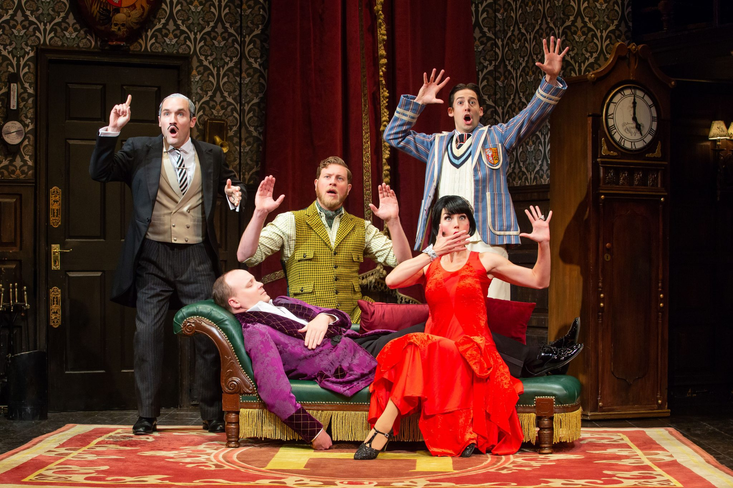
KEY KNOWLEDGE
Component 3 of the AQA Drama exam is a Performance of 2 Extracts both worth (20 marks each and 40 marks in total ) 20% of GCSE
KNOWLEDGE
Pupils must develop their ability to:
• interpret texts
• create and communicate meaning
• realise artistic intention in text-based drama.
UNDERSTANDING
Monologue (one performer) Must be between two and five minutes.
Duologue (two performers) Must be between three and ten minutes.
Group performance (three or more
performers)
Must be between four and twenty minutes.
ASSESSMENT
For this component students must complete two assessment tasks:
• study and present a key extract (monologue, duologue or group performance)
• study and present a second key extract (monologue, duologue or group performance) from the same play.
KEY VOCABULARY
KS4 DRAMA
KVO:
Component 3
Research your chosen play
Plot
Social Context
Characters
Relationships
How to approach a play
https://www.youtube.com/watch?v=1RRc4tq2kpE&t=13s
How to approach a monologue
https://www.youtube.com/watch?v=keiHGOqpdGQ
Physical Skills | Vocal Skills | Theatrical Skills
Blocking | Relationship | Levels
Genre | Style | Social, Historical & Political Context
Dramatic Intent | Effect | Convey
Evaluate | Analyse | Describe
Review | Proxemics | Explain

