Slide 1
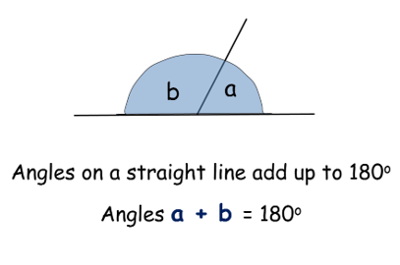
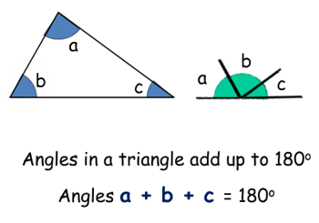
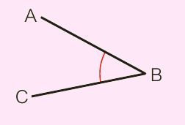
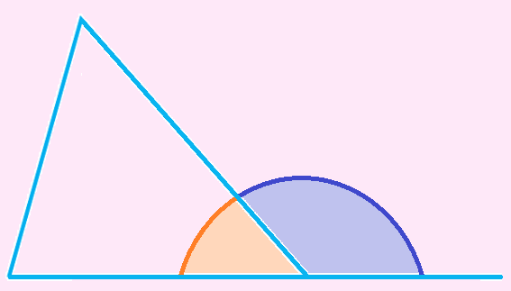
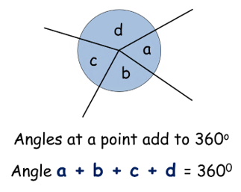
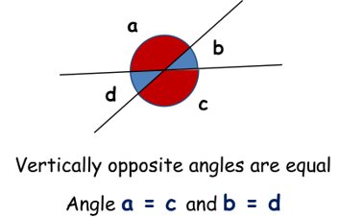
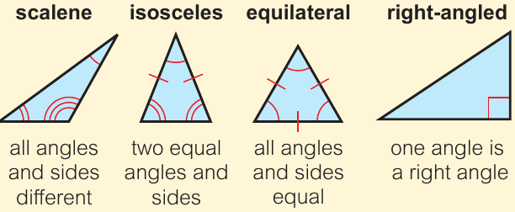
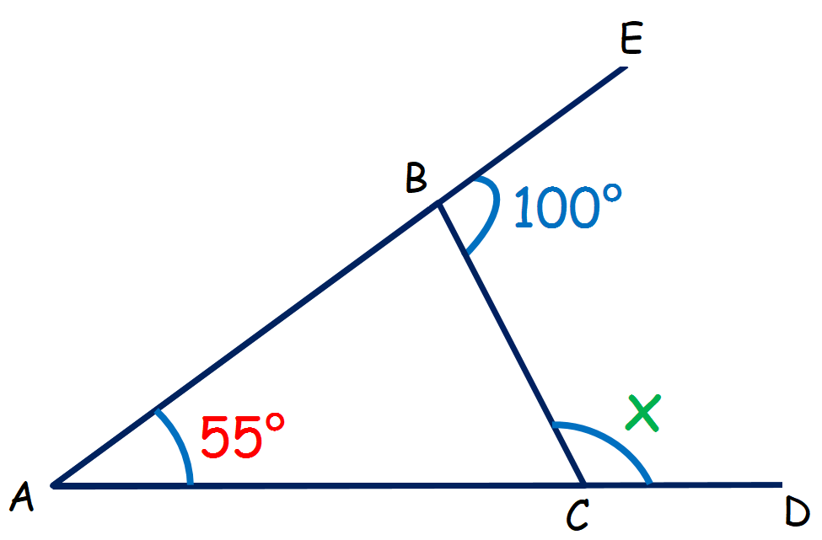
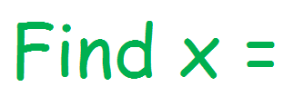
KEY VOCAB
KEY KNOWLEDGE
Protractors are tools used to measure angles with in degrees.
Estimate is a rough calculation of a number or quantity. It is not exact.
Acute angles measure more than 0° and less than 90°.
Obtuse angles measure more than 90° and less than 180°.
Reflex angles measure more than 180° and less than 360°.
Angles on a straight line Angles in a triangle
Angle Notation
Exterior angles are angles outside of a shape.
MATHS
Y7 Angles
Angles around a point Vertically opposite angles
Interior angles are angles inside of a shape.
Worked Example:
Types of Triangles
Angle | Reason
< ABC = 80° | Angles on a straight line sum to 180°.
< ACB = 45° | Angles in a triangle sum to 180°.
< BCD = 135° | Angles on a straight line sum to 180°.
FURTHER READING
https://www.bbc.co.uk/bitesize/topics/zdr9wmn
https://corbettmaths.com/contents/
https://www.pearsonactivelearn.com/app/library
< BCD or ‘x’ = 135°

