Slide 1
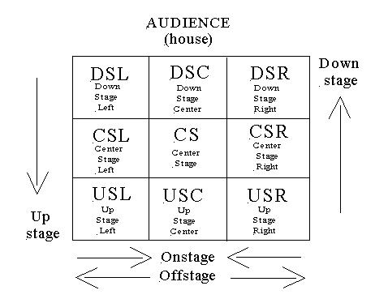
KEY KNOWLEDGE
In this unit of work you will:
Develop your understanding of 1920s New York
Develop your understanding of how to create character different from yourselves using skills such as accent, body language and gesture.
Practically explore some of the scenes within the play with a focus on characterisation, staging, and slapstick comedy.
Year 7
DRAMA
Bugsy Malone
FURTHER READING
Research New York in the 1920s
Watch the full version of Bugsy Malone on YouTube!
HOMEWORK
Create a poster marketing a school production of Bugsy Malone. Your aim is to sell ticket and make £££!
It must include:
The date, time, and place of the show
Ticket details
An eye-catching design
KEY VOCABULARY
Characterisation | Accent | Staging | Blocking | Director
Atmosphere | Slapstick | Comedy | Props | Actor
Gangster | Spoof | Genre | Musical | Marketing

