Slide 1
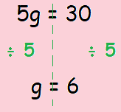
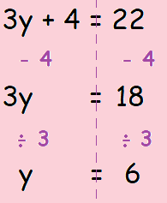
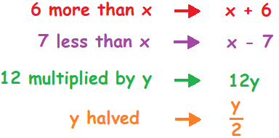
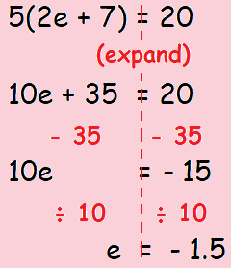
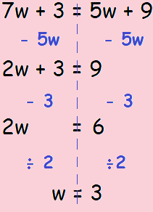
KEY VOCAB
KEY KNOWLEDGE
Equations are mathematical sentences that contains an equals symbol, e.g. 2x + 3 = 7
Operations in maths refers to how you change a number, e.g. to add, subtract, multiply, divide, squaring and so on.
Inverse refers to the opposite of another operation, e.g. the inverse of addition is subtraction.
Inequalities are the relationships between two expressions which are not equal to one another. The symbols used for inequalities are <, >, ≤, ≥ and ≠.
One step equation
Two step equation
MATHS
Y7 Equations
Equation with brackets
Equation with the
unknown on both sides
Use the number line to show the values that satisfy each inequality …
FURTHER READING
https://www.bbc.co.uk/bitesize/topics/z83rkqt
https://corbettmaths.com/contents/
https://www.pearsonactivelearn.com/app/library

