Slide 1
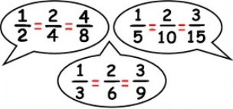
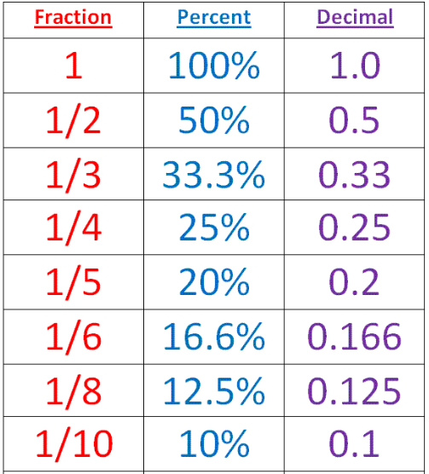
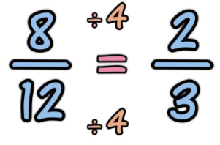
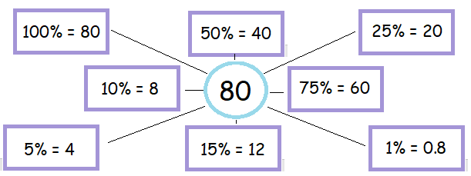
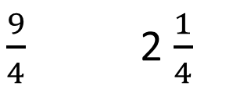
KEY VOCAB
KEY KNOWLEDGE
Numerator is the top part of a fraction.
Denominator is the bottom part of a fraction.
Mixed numbers are whole numbers and a fraction combined into one.
Improper fractions are fractions whereby the numerator is greater than the denominator.
Improper Fraction Mixed Number
Numerator
$\frac{9}{4}$ 2 $\frac{1}{4}$
Denominator
Equivalent Fractions
Equivalent fractions have the same value, even though they may look different.
Conversions to remember…
PERCENT
MATHS
Y7 Fractions,
Decimals &
Percentages
Per
100
OR ‘out of 100’
Simplifying Fractions
Simplifying a fraction reduces a fraction to its lowest terms.
Hint: look for the highest common factor of the numerator and denominator to speed things up!
Is it possible to have 110%? When could this happen?
When adding and subtracting fractions you must make sure the denominators are the same. You can do this by finding common factors and forming equivalent fractions.
FURTHER READING
https://www.bbc.co.uk/bitesize/guides/zgg4jxs/revision/1 https://corbettmaths.com/contents/
https://www.pearsonactivelearn.com/app/library

