Slide 1
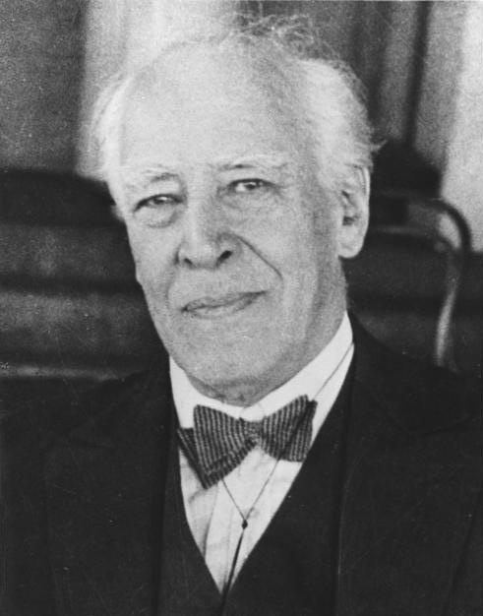
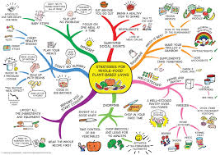
KEY KNOWLEDGE
The objective of this unit of work is to:
Introduce you to the basic skills and expectations in Drama
Teach you how to effectively warm up the body and mind
Develop your knowledge of to how to create a believable character using the theories of Stanislavski.
UNDERSTANDING STANISLAVSKI
Who is this? ________________________________________________
What was he famous for? ________________________________________________________________________
How did he help actors?
________________________________________________________________________
CHALLENGE TASK
Create a series of warm ups that explore character.
Warm-up games are very important and beneficial for any drama class:
They are fun and enjoyable
The help a group to get to know one another
They help to focus your mind on drama
The help to warm-up your body
They help shy people to get involved with the group
The help us to use our imagination and creativity
They promote trust
Year 7
DRAMA Intro and Character
CHALLENGE TASK
Create a mind-map or character collage which describes your character
PHYSICAL SKILLS | VOCAL SKILLS
Body Language Facial Expression Posture Gesture Eye Contact Walk | Accent Diction Inflection Emphasis Tone Pitch Pace Projection
KEY VOCABULARY – Can you learn these spellings?
Hot-Seating | Emotion Memory | Magic If | Naturalistic | Realism
Proxemics | Given Circumstances | Focus | Improvisation | Creativity
Detail | Believable Characters | Mannerisms | Continuity | Audience

