Slide 1
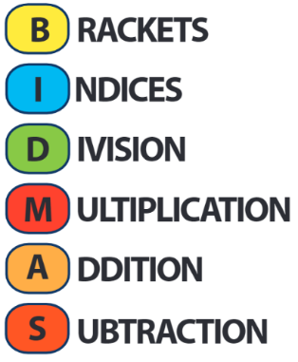
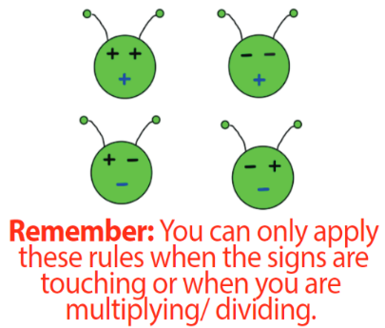
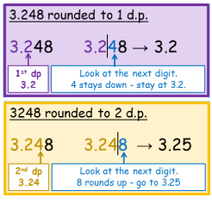
KEY VOCAB
Prime numbers will only divide by themselves and 1. Here are the first twelve prime numbers: 2, 3, 5, 7, 11, 13, 17, 19, 23, 29, 31, 37.
Square numbers are a result of a number being multiplied by itself.
For example, 25 is a square number because 5 x 5 = 25.
Another square number would be 49 because 7 x 7 = 49.
Can you see why the numbers below are called triangular numbers?
Integers are whole numbers that can be positive, negative or zero.
Multiples are just times tables. Multiples of 5 are 5, 10, 15, 20, 25 …
Factors is a number that divides into another number exactly and without leaving a remainder. Factors of 10 are 1, 2, 5 and 10.
KEY KNOWLEDGE
Lowest Common Multiple (LCM) is the first number in the times tables of two or more numbers.
3’s: 3, 6, 9, 12, 15, 18, 21, 24
7’s: 7, 14, 21, 28, 35
LCM of 3 and 7 = 21
MATHS
Y7 Number
Order of Operations
Addition: Add, plus, sum, more, total...
Subtraction: Difference, take away, minus…
Multiplication: Times, product, lots of, multiply…
Division: Share, splitting into equal parts…
Highest Common Factor (HCF) is the biggest factor that divides into two or more numbers.
30 12
1 x 30 1 x 12
2 x 15 2 x 6
3 x 10 3 x 4
5 x 6
HCF of 30 and 12 = 6
Negative Numbers
Rounding Decimal Places
FURTHER READING
https://www.bbc.co.uk/bitesize/topics/z7kw2hv
https://corbettmaths.com/contents/
https://www.pearsonactivelearn.com/app/library

