Slide 1
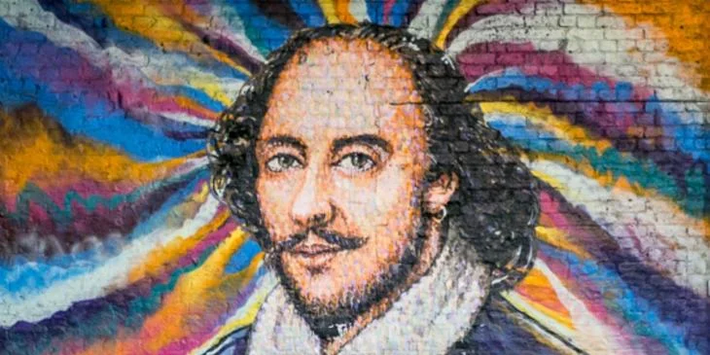
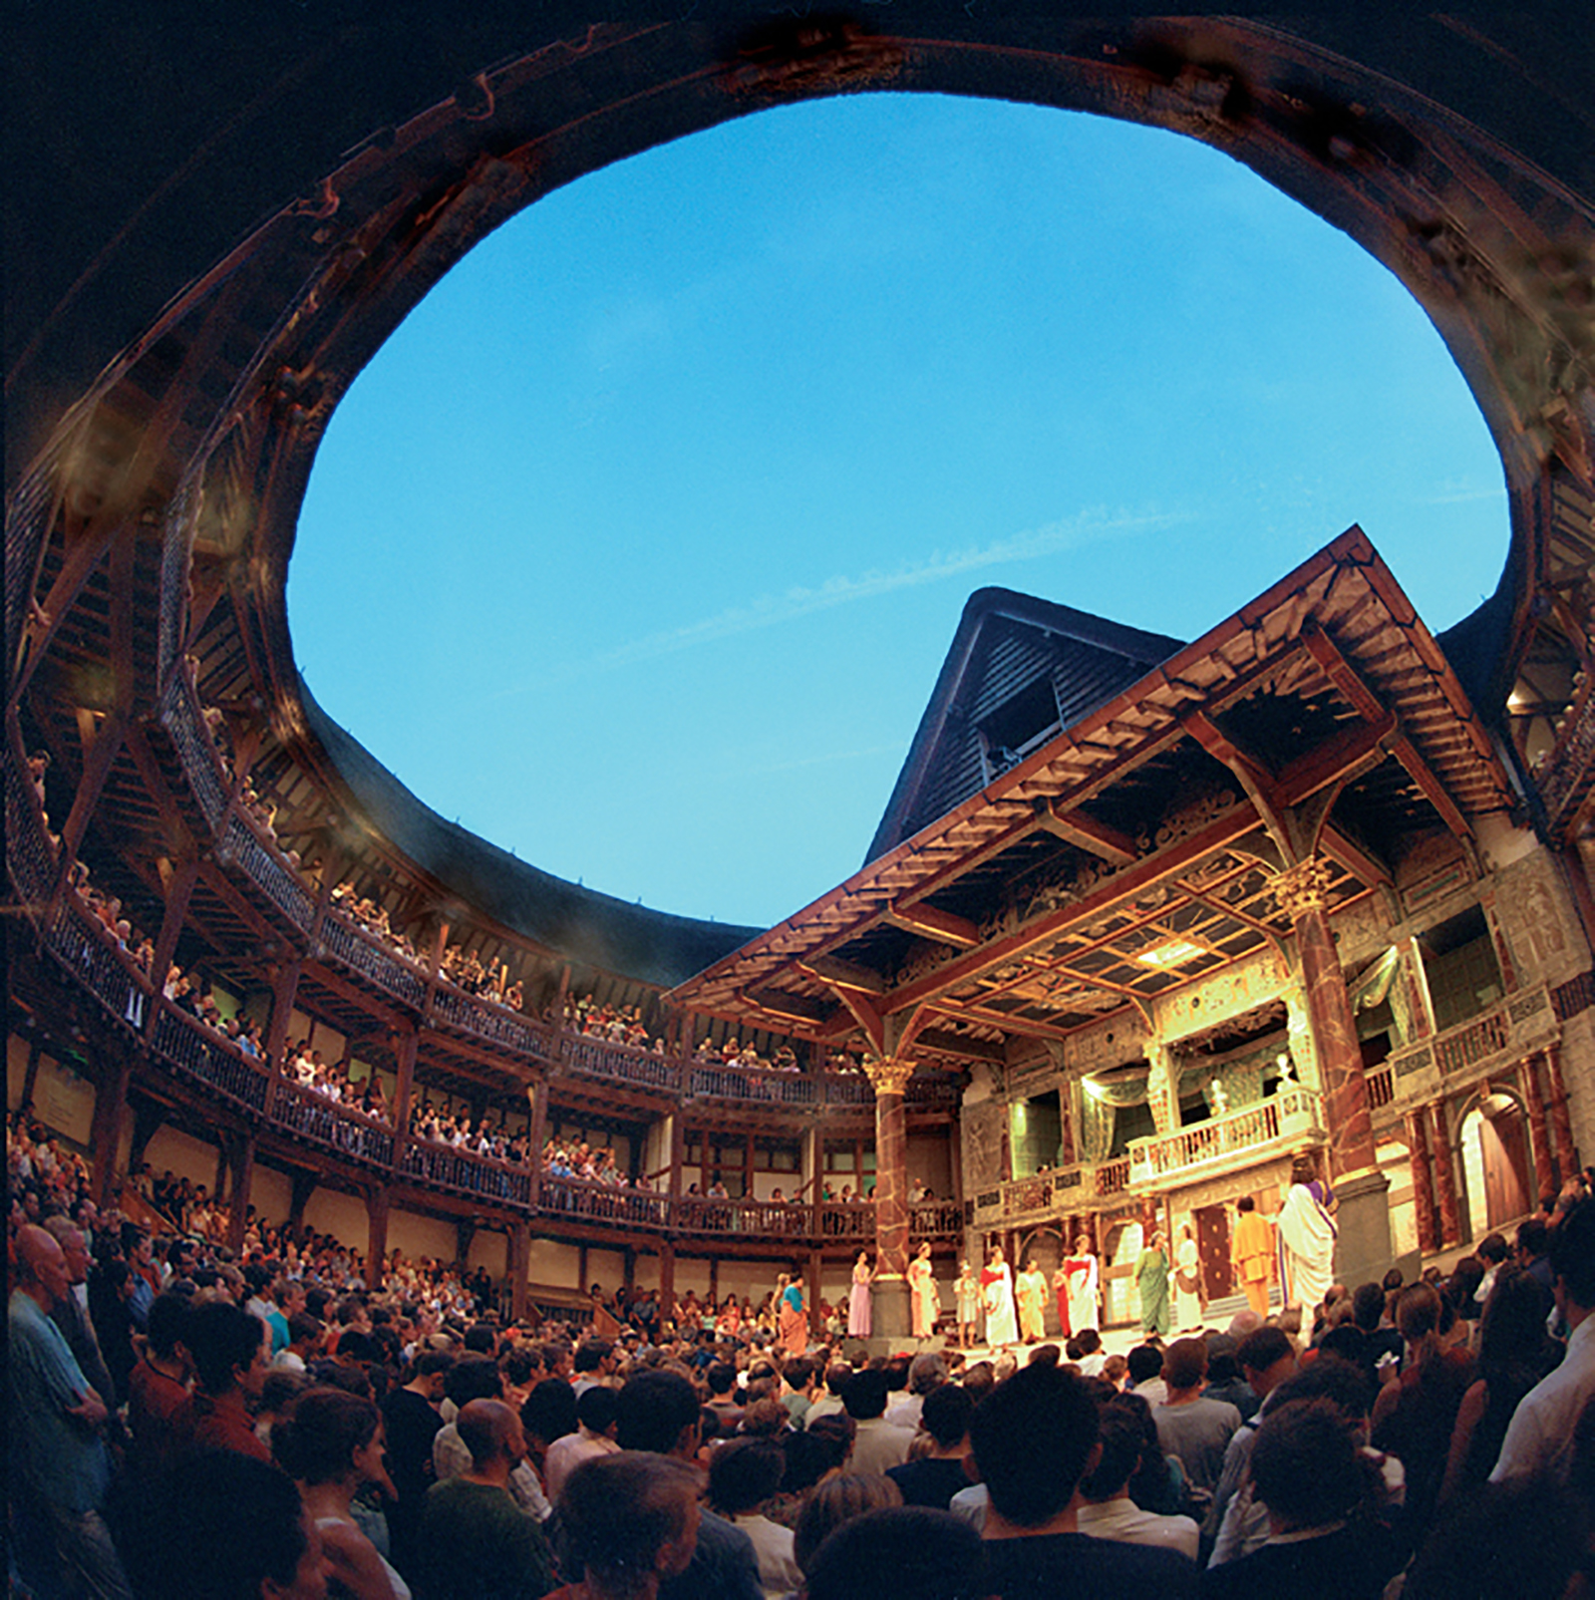
KEY KNOWLEDGE
To be introduced to Shakespeare and to consider the themes and storylines that run through the work.
To gain an insight into how Shakespeare is used today.
Be able to apply these skills practically in performance.
What do these words mean:
whining
Satchel
furnace
oaths
capon
Pantaloon
Hose
Sans
William Shakespeare was an English playwright, poet, and actor, widely regarded as the greatest writer in the English language and the world's greatest dramatist. He is often called England's national poet. He was born in 1564 in the Tudor period.
He wrote over 150 poems and 37 plays
https://youtu.be/xlqi5k0Z3ps
write a paragraph about The Globe.
Year 7
Shakespeare
CHALLENGE TASK 1
Watch this video and
KEY VOCABULARY – Can you learn these spellings?
Globe | Elizabethan | Gait | Soliloquy | Prologue
Tragedy | History | Comedy | The Bard | Sonnet
Hamlet | Romeo and Julliet | Movement | Macbeth | Playwright

