Slide 1
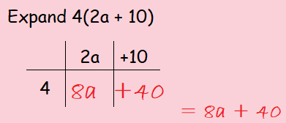
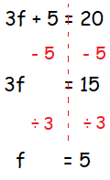
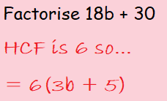
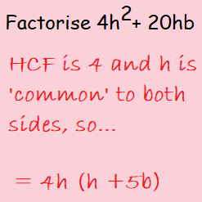
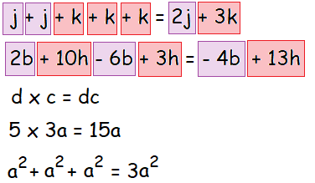
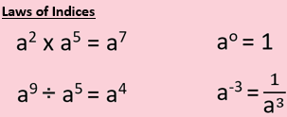
KEY VOCAB
KEY KNOWLEDGE
Expressions are numbers, symbols and operations that are grouped together to show the value of something, e.g. 3x + 4.
Formulae are a facts or rules that use mathematical symbols. It will usually have an equals sign and two or more variables (e.g. x and y) that stand in for values we don't know yet.
Sequences are an ordered list of numbers. Each number in the sequence is called a term. In the sequence 1, 3, 5, 7, 9, …, 1 is the first term, 3 is the second term, 5 is the third term, and so on.
Expand means to make larger or more extensive.
Factorise means to put back into brackets.
Simplifying Algebraic Expressions
Make F the Subject
MATHS
Y8 Algebraic
Manipulation
Finding the nth Term
Arithmetic Sequence
Each term is found by adding or subtracting the previous one by the same number.
4, 6, 8, 10, 12 …
Geometric Sequence
Each term is found by multiplying the previous one by the same number.
3, 6, 12, 24, 48, …
FURTHER READING
https://www.bbc.co.uk/bitesize/topics/z4f3cdm
https://corbettmaths.com/contents/
https://www.pearsonactivelearn.com/app/library

