Slide 1
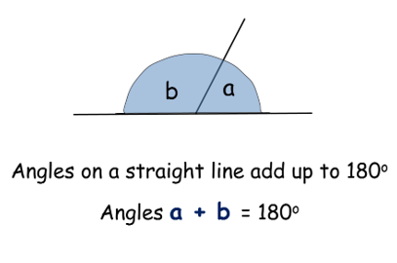
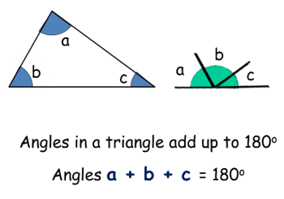
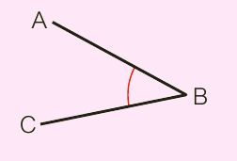
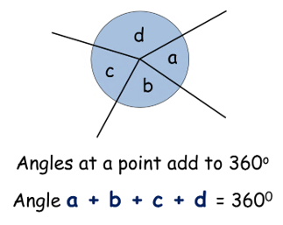
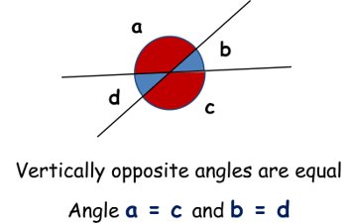
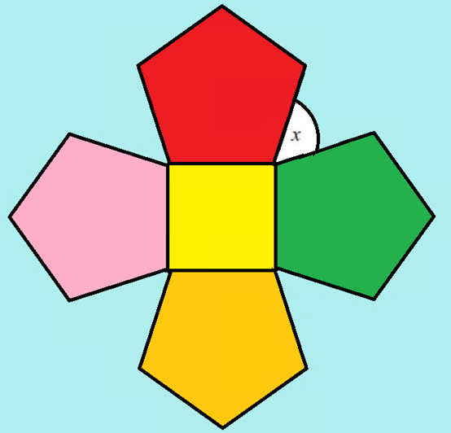
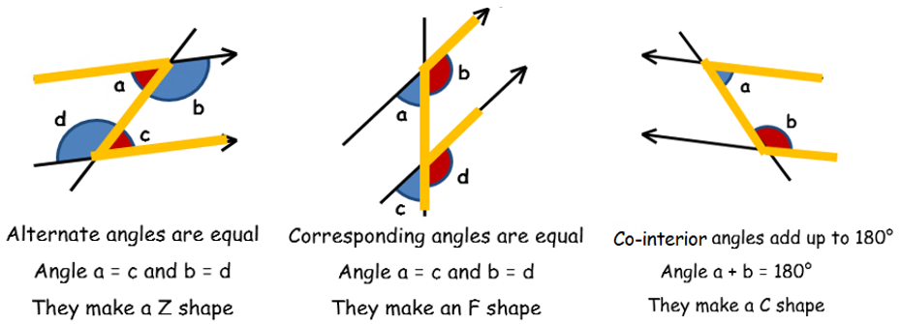
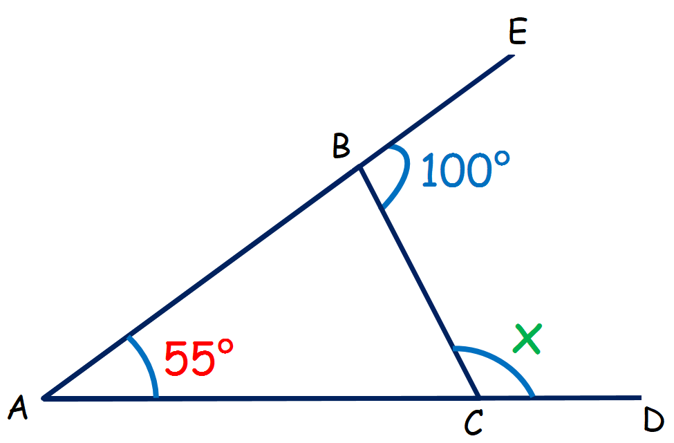
KEY VOCAB
KEY KNOWLEDGE
Estimate is a rough calculation of a number or quantity. It is not exact.
Quadrilaterals are 2D shapes with four straight sides.
Polygons are any closed 2D shape with straight sides.
Interior angles are angles inside of a shape.
Exterior angles are angles outside of a shape.
Angles on a straight lines Angles in a triangle
Angle Notation
Angles in Polygons
Exterior angles of any
polygon add to 360°
Sum of interior angles =
(Number of sides – 2 ) x 180°
MATHS
Y8 Angles
Angles around a point Vertically opposite angles
All interior angles of a hexagon:
(6 – 2) x 180°
= 720°
Calculate x
Angles in parallel lines
One interior angle of a hexagon:
720° ÷ 6 angles
= 120 °
Worked Example:
Angle | Reason
< ABC = 80° | Angles on a straight line sum to 180°.
< ACB = 45° | Angles in a triangle sum to 180°.
< BCD = 135° | Angles on a straight line sum to 180°.
FURTHER READING
https://www.bbc.co.uk/bitesize/topics/zdr9wmn
https://corbettmaths.com/contents/
https://www.pearsonactivelearn.com/app/library
< BCD or ‘x’ = 135°

