Slide 1
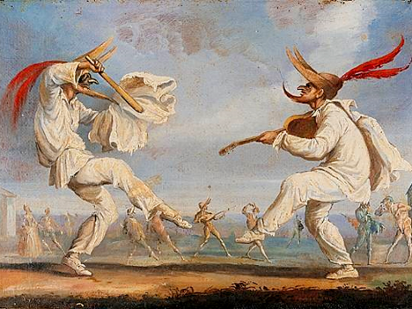
KEY KNOWLEDGE
The objectives of this scheme of work are:
To understand what makes people laugh in the theatre.
To develop an understanding of the physical movement that is the basis of Commedia D’ell Arte
To develop an understanding of the stock characters from commedia dell’arte
To devise an interesting piece of theatre using styles you have learnt.
Year 8
DRAMA
Commedia
D’ell Arte
https://en.wikipedia.org/wiki/Commedia_dell%27arte
https://www.youtube.com/watch?v=h_0TAXWt8hY
https://learningthroughtheatre.co.uk/commedia
FURTHER READING
Body Language
Exaggeration
Key Skills
Gramalot
Physical Theatre
Facial Expression
Gesture
What is a Gramalot?
__________________________
_______________________
_______________________
_______________________
KEY VOCABULARY
Mime | Slapstick | Comedy | Stock characters | Impro
Physical Skills | Masters, Lovers and Servants | Lazzi | Characterisation | Music

