Slide 1
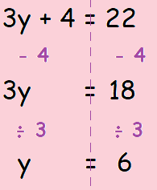
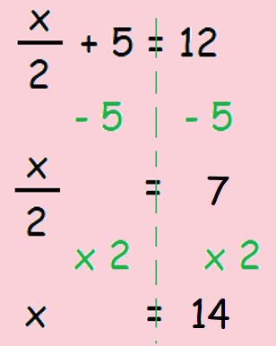
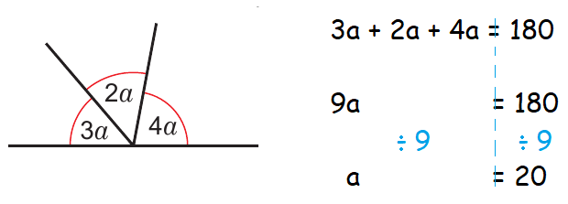
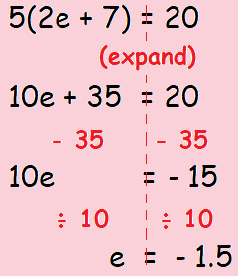
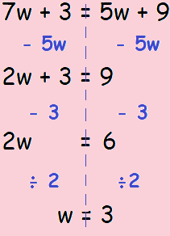
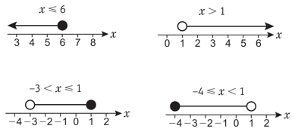
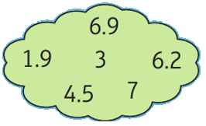
KEY VOCAB
KEY KNOWLEDGE
Equations are mathematical sentences that contains an equals symbol, e.g. 2x + 3 = 7
Operations in maths refers to how you change a number, e.g. to add, subtract, multiply, divide, squaring and so on.
Inverse refers to the opposite of another operation, e.g. the inverse of addition is subtraction.
Inequalities are the relationships between two expressions which are not equal to one another. The symbols used for inequalities are <, >, ≤, ≥ and ≠.
Two step equations
Find the value of a
MATHS
Y8 Equations
o
o
Equation with brackets
Equation with the
unknown on both sides
o
Examples of Inequalities…
Which numbers in the cloud belong to the inequality…
3 < x ≤ 7
FURTHER READING
https://www.bbc.co.uk/bitesize/topics/z83rkqt
https://corbettmaths.com/contents/
https://www.pearsonactivelearn.com/app/library

