Slide 1
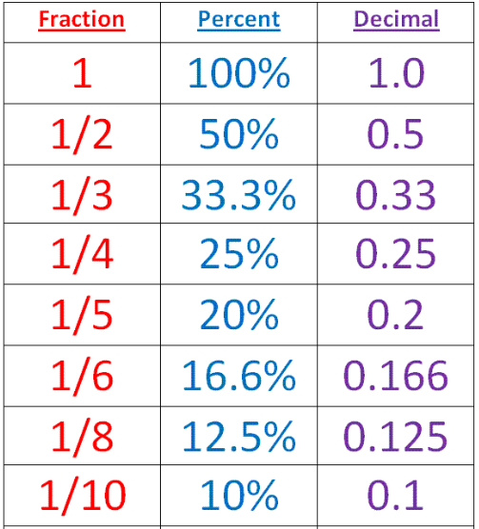
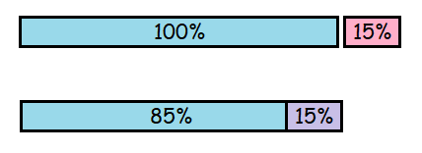
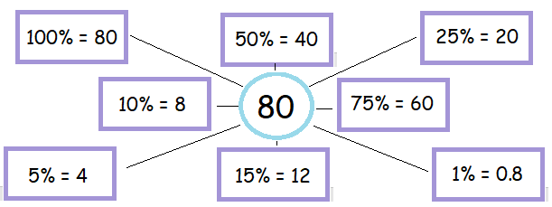
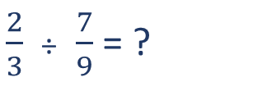
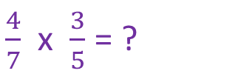
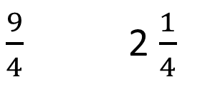
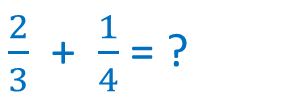
KEY VOCAB
KEY KNOWLEDGE
Equivalent fractions have the same value even though they may look different, e.g. $\frac{2}{4}$ and $\frac{1}{2}$ .
The reciprocal of a number is 1 divided by that number.
E.g. the reciprocal of 3 is 1 divided by 3, which is $\frac{1}{3}$.
Recurring decimals contain a digit, or series of digits which repeats itself forever, e.g. 0.7
Terminating decimals end after a definite number of digits, e.g. 0.22 or 0.519.
Improper Fraction Mixed Number
Numerator
$\frac{9}{4}$ 2 $\frac{1}{4}$
.
Denominator
$\frac{2}{3}$ + $\frac{1}{4}$ = ?
When adding and subtracting fractions you must make sure the denominators are the same first. You can do this by finding common factors and forming equivalent fractions.
Conversions to remember…
PERCENT
MATHS
Y8 Fractions,
Decimals &
Percentages
Per
When multiplying fractions you must multiply the two numerators. Then, multiply the two denominators.
$\frac{4}{7}$ x $\frac{3}{5}$ = ?
100
OR ‘out of 100’
$\frac{2}{3}$ ÷ $\frac{7}{9}$ = ?
When dividing fractions you must find the reciprocal of the second fraction. Next, multiply the two numerators. Then, multiply the two denominators.
Is it possible to have 110%? When could this happen?
Decimal Multipliers
Increase £40 by 15%
Decrease $16 by 15%
115% so… £40 x 1.15 = £46
85% so … $16 x 0.85 = $13.60
FURTHER READING
https://www.bbc.co.uk/bitesize/guides/zgg4jxs/revision/1 https://corbettmaths.com/contents/
https://www.pearsonactivelearn.com/app/library

