Slide 1
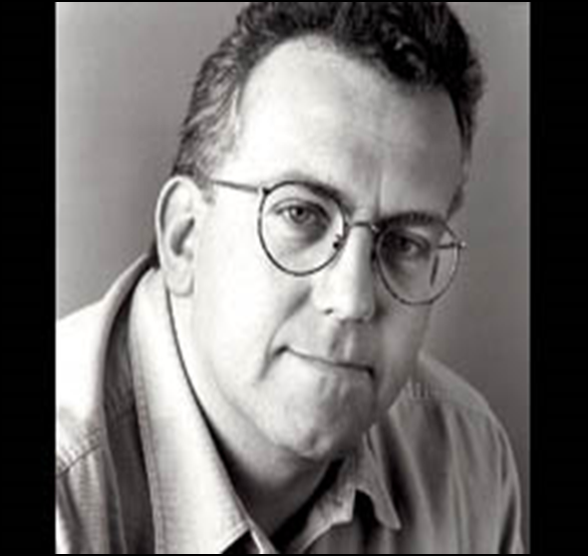
KEY KNOWLEDGE
The objective of this scheme of work is to develop your knowledge of John Godber’s style of theatre. You will also explore this style practically.
The expected outcomes are:
You understand the key features of Godber’s style
You are able to perform successfully in the style of Godber’s plays
You develop your characterisation, multirole and comedy skills.
Actors rarely leave the stage
Year 8
DRAMA
John Godber
FURTHER READING
Research some of John Godber’s plays, some examples are:
Bouncers
Shakers
Teechers
Minimal set/props
Short Scenes
Features of Godber’s style
Fast pace
Comedic, stereotypical, usually working class characters
KEY VOCABULARY
What is a stereotype?
_______________________
_______________________
_______________________
Multirole | Fast Pace | Comedy | Lighting | Music
Face out the Drama | Choral Movement | Choral Speaking | Stereotypes | Snap Transitions

