Slide 1
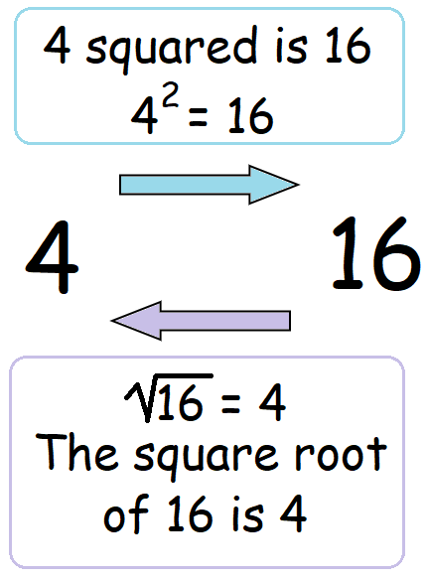
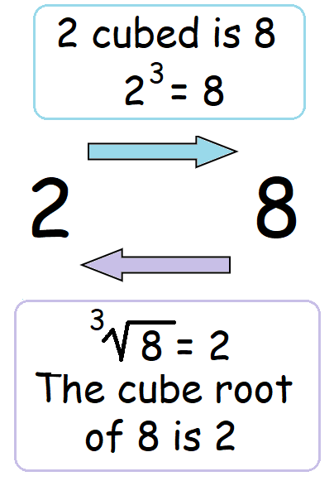
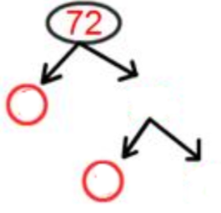
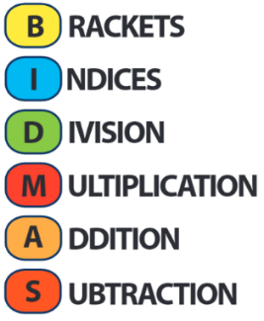
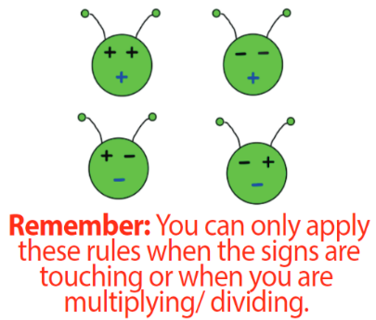
KEY VOCAB
Prime numbers will only divide by themselves and 1. Here are the first twelve prime numbers: 2, 3, 5, 7, 11, 13, 17, 19, 23, 29, 31, 37.
Can you see why the numbers below are called triangular numbers?
Integers are whole numbers that can be positive, negative or zero.
Multiples are just times tables. Multiples of 5 are 5, 10, 15, 20, 25 …
Factors is a number that divides into another number exactly and without leaving a remainder. Factors of 10 are 1, 2, 5 and 10.
Index notation is a way of representing repeated multiplications of the same number. For example 5² x 6³ is index notation which also means 5 x 5 x 6 x 6 x 6.
Write 72 as a product of its primes
Square Numbers
Cube Numbers
Hint: Try to find two factors where one of them is prime!
KEY KNOWLEDGE
MATHS
Y8 Number
Order of Operations
Negative Numbers
Lowest Common Multiple (LCM) is the first number in the times tables of two or more numbers.
3’s: 3, 6, 9, 12, 15, 18, 21, 24
7’s: 7, 14, 21, 28, 35
LCM of 3 and 7 = 21
Highest Common Factor (HCF) is the biggest factor that divides into two or more numbers.
30 12
1 x 30 1 x 12
2 x 15 2 x 6
3 x 10 3 x 4
5 x 6
HCF of 30 and 12 = 6
Significant Figures
FURTHER READING
https://www.bbc.co.uk/bitesize/topics/z7kw2hv
https://corbettmaths.com/contents/
https://www.pearsonactivelearn.com/app/library

