Slide 1
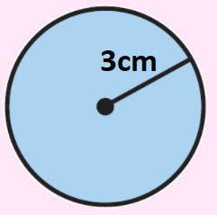
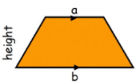
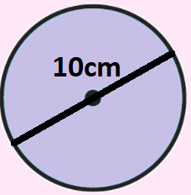
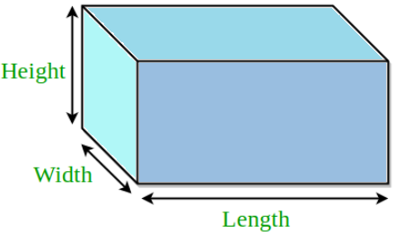
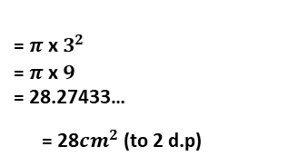

KEY VOCAB
KEY KNOWLEDGE
Perimeter is the distance measured around a 2D shape. You add to reach your answer.
Area is the space measured inside a 2D shape. You multiply to reach your answer.
Volume is the space measured inside a 3D shape.
Compound shapes are made up of two or more 2D shapes (for example, an ‘L’ shape is made up of two rectangles).
Area of a rectangle Area of a triangle
Area of a circle Circumference of a circle
MATHS
Y8 Area,
Perimeter & Volume
$$=π {\text{x} radius}^{2}$$
$$=π {\text{x} diameter}^{}$$
Area of a trapezium Area of a parallelogram
= $π {\text{x} 3}^{2}$
= $π {\text{x} 9}^{}$
= 28.27433…
= 28${cm}^{2}$ (to 2 d.p)
= $π {\text{x} 10}^{}$
= 31.4159265…
= 31cm (to 2 d.p)
Volume of a cuboid
Length Conversions
1 cm = 10 mm
1 m = 100 cm
1 km = 1000 m
1 mile = 1.6 km
Surface area of a cuboid
Volume = Height x Width x Length
FURTHER READING
https://www.bbc.co.uk/bitesize/topics/zrf3cdm
https://corbettmaths.com/contents/
https://www.pearsonactivelearn.com/app/library

