Slide 1
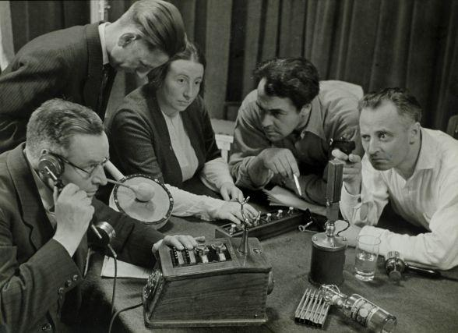
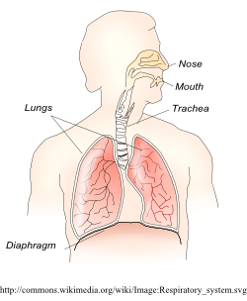
KEY KNOWLEDGE
To know and understand the purpose of Radio Drama
To know and understand how to create and develop ideas to communicate meaning for theatrical performance on the Radio.
To apply the techniques to your own scripted Radio play.
To know and understand how the voice works and how it should be used in performance.
FURTHER LISTENING
https://www.bbc.co.uk/sounds/play/m0017tjv
Listen to the most famous radio play series ever!!
Year 8
Radio Plays and Use of the Voice
Why are Sound effects used in a Radio Play?
KEY VOCABULARY
Elements | Dialogue | Narration | Sound Effects | Music
Script | Technology | Story | Voice Box | Diaphragm

