Slide 1
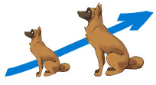
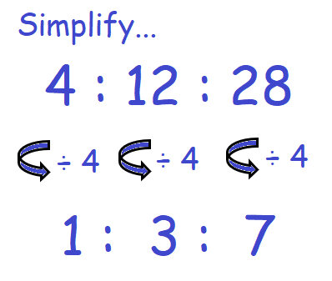
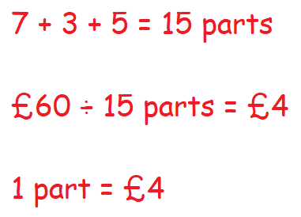

KEY VOCAB
KEY KNOWLEDGE
Ratio shows how much of one quantity there is of something compared to another.
They are usually written in the form a:b. The order in which a ratio is stated is important.
Equivalent ratios have the same value even though they may look different, e.g. 50:100 and 1:2.
Proportion is when two or more quantities have the same relative size.
Unitary means the value of a single unit. Think of other words that begin with ‘uni’ meaning ‘one’ such as unicycle, unison, uniform etc.
Directly Proportional is when one amount increases, another amount increases at the same rate.
The symbol for "directly proportional " is
Inversely Proportional is when one value decreases at the same rate that the other increases.
Dog: Ears, tail and legs will grow at the same rate.
Another example; if you are paid £15 an hour then:
2 hours work = £30
3 hours work = £45
10 hours work = £150
Simplifying Ratios
30 out of 200 students
travel to school by bus.
Write this proportion as a…
Decimal
30 ÷ 200 = 0.15
Fraction
$\frac{30}{200}$ or in it’s simplest form $\frac{3}{20}$
Percentage
$\frac{30}{200} \frac{15}{100}$ = 15%
MATHS
Y8 Ratio &
Proportion
Seesaw: As one person goes up, the other goes down.
Another example; think about if you travelling are in a car:
As speed increases, travel time decreases.
Alternatively as speed increases, travel time decreases.
÷ 2
Jane made a drink using blackcurrant and water in the ratio 3:8. Scott made the same drink but in the ratio 4:10.
Who’s drink is stronger?
Step 1
Step 2
FURTHER READING
https://www.bbc.co.uk/bitesize/topics/zxw76sg
https://corbettmaths.com/contents/
https://www.pearsonactivelearn.com/app/library

