Slide 1
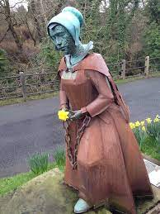
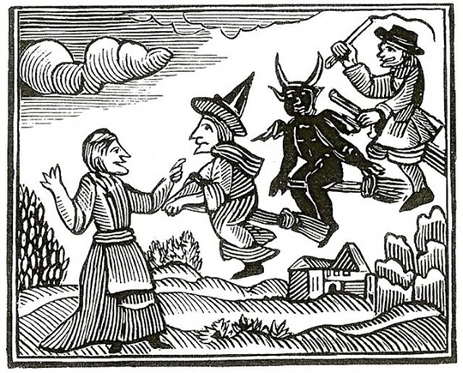
KEY KNOWLEDGE
The objective of this unit of work is to:
Introduce you the basic conventions of Verbatim Theatre​
To be able to know and understand how to develop a piece of scripted drama. ​
To be able to work collaboratively in groups to improve drama skills.
UNDERSTANDING THE PENDLE WITCH TRIALS
1. Who was the King of England at the time of the Pendle Witch Trials?
​__________________________________________________
2. What is the name of Jennet’s Grandmother?​
__________________________________________________
​ 3. What happened to the Pedlar?
_____________________________________________________________________________
KEY FEATURES OF VERBATIM THEATRE
Verbatim theatre is a form of documentary theatre which is based on the spoken words of real people, often taken from recorded interviews.
Year 8
DRAMA
VERBATIM THEATRE
Actors often remain onstage throughout a performance.
CHALLENGE TASK 1
Research 2 facts about the Pendle Witch Trial that you will be asked to share with the class.
CHALLENGE TASK 2
Research the character you are playing – The Pendle Witch Child.
Actors speak directly to the audience (direct address)
Use of narration
KEY VOCABULARY – Can you learn these spellings?
Verbatim | Transcript | Clear Vocals | Documentary | Research
Theatre | Ensemble Performance | Script work | Narration | Still Image
History | Facial Expressions | Exaggeration | Body Language | Diction

