Slide 1
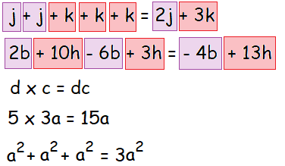
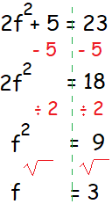
KEY VOCAB
KEY KNOWLEDGE
Expressions are numbers, symbols and operations that are grouped together to show the value of something, e.g. 3x + 4.
Formulae are a facts or rules that use mathematical symbols. It will usually have an equals sign and two or more variables (e.g. x and y) that stand in for values we don't know yet.
Sequences are an ordered list of numbers. Each number in the sequence is called a term. In the sequence 1, 3, 5, 7, 9, …, 1 is the first term, 3 is the second term, 5 is the third term, and so on.
Expand means to make larger or more extensive.
Factorise means to put back into brackets.
Simplifying Algebraic Expressions
Make F the Subject
MATHS
Y9 Algebraic
Manipulation
Finding the nth Term of a Geometric Sequence
Arithmetic Sequence
Each term is found by adding or subtracting the previous one by the same number.
4, 6, 8, 10, 12 …
Geometric Sequence
Each term is found by multiplying the previous one by the same number.
3, 6, 12, 24, 48, …
FURTHER READING
https://www.bbc.co.uk/bitesize/topics/z4f3cdm
https://corbettmaths.com/contents/
https://www.pearsonactivelearn.com/app/library

