Slide 1
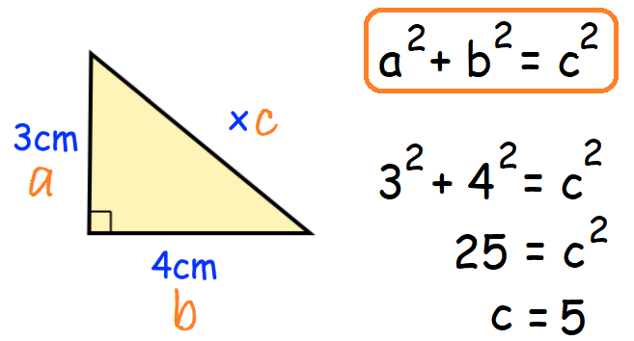
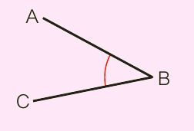
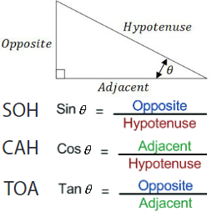
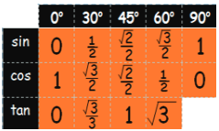
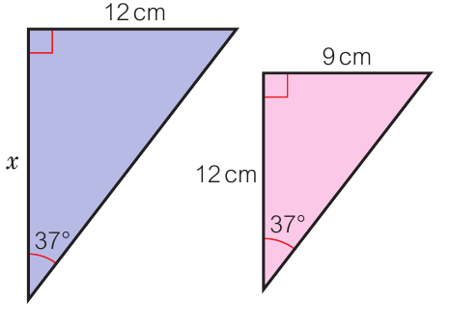
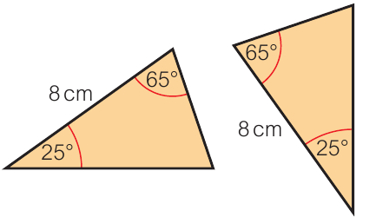
KEY VOCAB
KEY KNOWLEDGE
Quadrilaterals are 2D shapes with four straight sides.
Polygons are any closed 2D shape with straight sides.
Interior angles are angles inside of a shape.
Exterior angles are angles outside of a shape.
Pythagoras’ Theorem
Remember!
When labelling your right angled triangle c is always the hypotenuse.
Hypotenuse is the longest side of a triangle and is always opposite the right angle.
Angle Notation
MATHS
Y9 Angles
Angles in Polygons
Exterior angles of any
polygon add to 360°
Sum of interior angles =
(Number of sides – 2 ) x 180°
All interior angles of a hexagon:
(6 – 2) x 180°
= 720°
Trigonometry
Remember!
You need to use the inverse button on your calculator to find the angle.
($\sin^{−1}$, $\cos^{−1} and \tan^{−1}\text{)}$
One interior angle of a hexagon:
720° ÷ 6 angles
= 120 °
Exact Trigonometric Values
Similar shapes are an
enlargement of the other.
The enlarged image may be a reflection
or rotations (or both) of an object.
Congruent shapes can be
recognised if they have:
SSS (side, side, side)
ASA (angle, side, angle)
SAS (side, angle, side)
AAS (angle, angle side)
FURTHER READING
https://www.bbc.co.uk/bitesize/topics/zdr9wmn
https://corbettmaths.com/contents/
https://www.pearsonactivelearn.com/app/library
These are congruent because of ASA.

