Slide 1
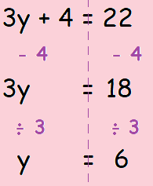
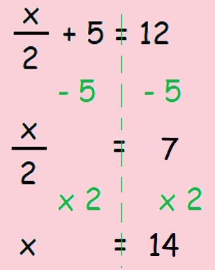
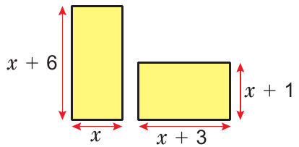
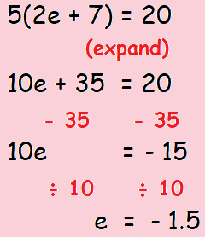
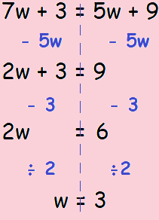
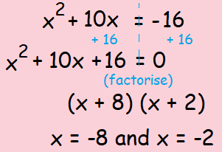
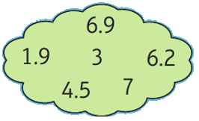
KEY VOCAB
KEY KNOWLEDGE
Equations are mathematical sentences that contains an equals symbol, e.g. 2x + 3 = 7
Operations in maths refers to how you change a number, e.g. to add, subtract, multiply, divide, squaring and so on.
Inverse refers to the opposite of another operation, e.g. the inverse of addition is subtraction.
Inequalities are the relationships between two expressions which are not equal to one another. The symbols used for inequalities are <, >, ≤, ≥ and ≠.
Solving two step equations.
Solving equations
with brackets.
Solving equations with the
unknown on both sides.
The two rectangles have the same area. Find the value of x.
MATHS
Y9 Equations
Student Working & Answer:
Examples of Inequalities…
Which numbers in the cloud belong to the inequality…
3 < x ≤ 7
Solving quadratic equations by factorising
FURTHER READING
https://www.bbc.co.uk/bitesize/topics/z83rkqt
https://corbettmaths.com/contents/
https://www.pearsonactivelearn.com/app/library

