Slide 1
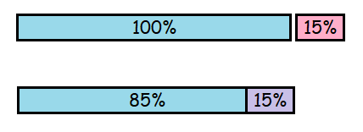
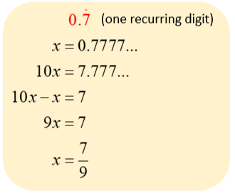
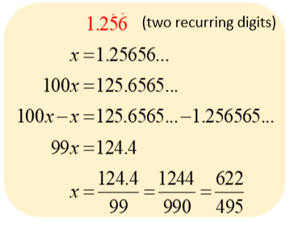


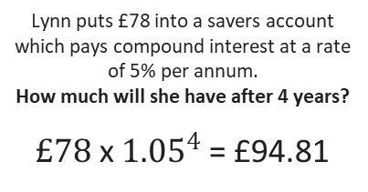


KEY VOCAB
KEY KNOWLEDGE
The reciprocal of a number is 1 divided by that number.
E.g. the reciprocal of 3 is 1 divided by 3, which is $\frac{1}{3}$.
Depreciation is a reduction in the value of something over time.
Interest is the cost of borrowing money normally shown as a yearly percentage.
E.g. 5% interest per annum (every year). A loan is a sum of money that is borrowed.
Compound interest is based on the original percentage amount and the interest that builds up on it in every year from the previous year.
$\frac{2}{3}$ + $\frac{1}{4}$ = ?
When adding and subtracting fractions you must make sure the denominators are the same first. You can do this by finding common factors and forming equivalent fractions.
When multiplying fractions you must multiply the two numerators. Then, multiply the two denominators.
$\frac{4}{7}$ x $\frac{3}{5}$ = ?
MATHS
Y9 Depth
Fractions,
Decimals &
Percentages
$\frac{2}{3}$ ÷ $\frac{7}{9}$ = ?
When dividing fractions you must find the reciprocal of the second fraction. Next, multiply the two numerators. Then, multiply the two denominators.
Compound Interest
Reverse Percentages
Lynn puts £78 into a savers account which pays compound interest at a rate of 5% per annum.
How much will she have after 4 years?
$£78$ x ${1.05}^{4}$ = £94.81
40% of a number is 32.
What is the number?
40% = 32
1% = 0.8
100% = 80
Decimal Multipliers
÷ 40
Increase £40 by 15%
Decrease $16 by 15%
x 100
115% so… £40 x 1.15 = £46
85% so … $16 x 0.85 = $13.60
Converting a recurring decimal into a fraction
FURTHER READING
https://www.bbc.co.uk/bitesize/guides/zgg4jxs/revision/1 https://corbettmaths.com/contents/
https://www.pearsonactivelearn.com/app/library

