Slide 1
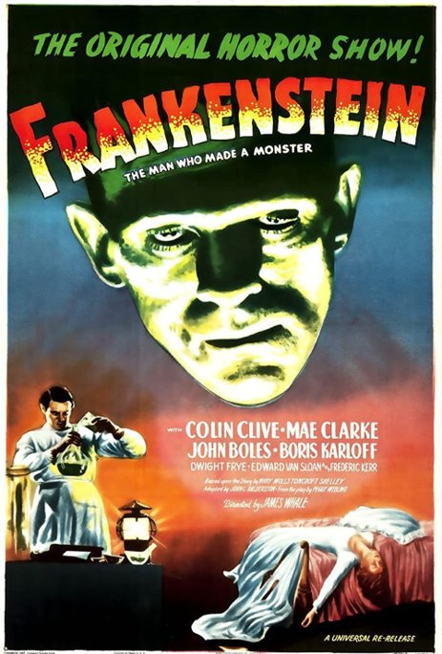
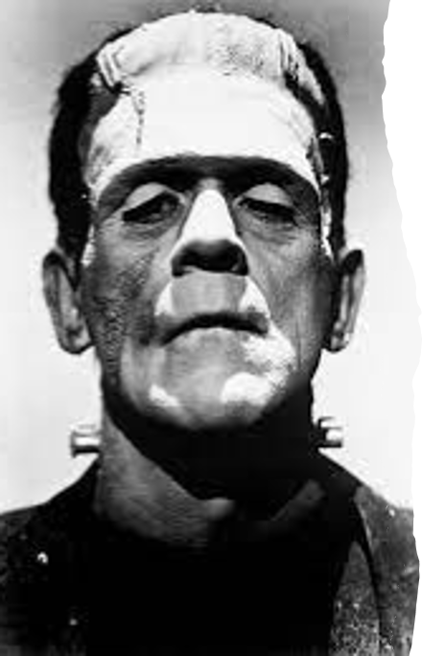
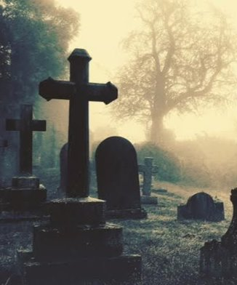
KEY KNOWLEDGE
The objective of this unit of work is to:
To explore in a practical context the theme of Gothic Horror through images and music.​​
To learn about tension and climax in drama​​
To consider what sound can add to a performance​​
To take on a variety of roles and perform to an audience.
Is Dr Frankenstein to blame for the deaths of Elizabeth, William, and Henry?
Yes, because… __________________________________________________________________________________________________________________________________
No, because… __________________________________________________________________________________________________________________________________
KEY FEATURES OF THE GOTHIC GENRE
A medieval style of architecture characterised by pointed arches and ornate stone-masonry​
A gloomy, morbid style of fashion and make up dominated by the colour black
A gloomy, morbid genre of music popular in the early 1980s;
A genre of literature focused on terror that was first popularised in the 18th century by Horace Walpole’s The Castle of Otranto.
Year 9
DRAMA
THE GOTHIC
CHALLENGE TASK
Create a spooky set design for the scene when Frankenstein’s Monster comes to life.
Remember to consider conventions of the genre and the atmosphere you would want to create.
KEY VOCABULARY – Can you learn these spellings?
Gothic | Supernatural | Dark | Atmosphere | Terror
Theatre | Script work | Gloomy | Conventions | Mystery
Genre | Creation of tension | Morbid | Spatial Awareness | Narrative

