Slide 1
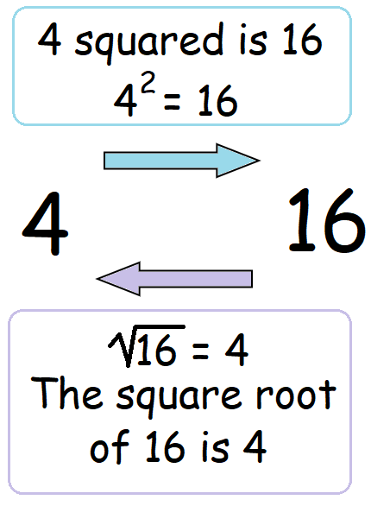
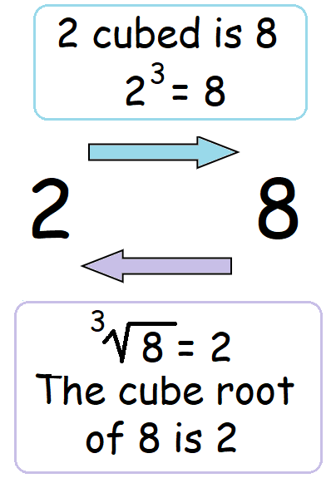
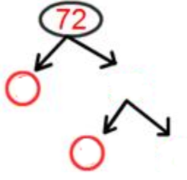
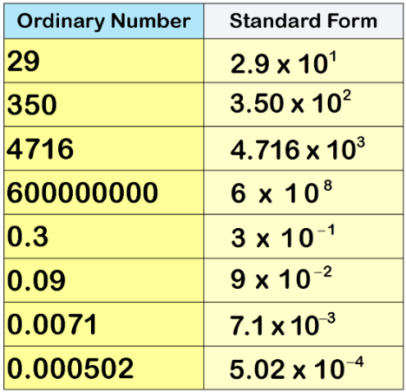
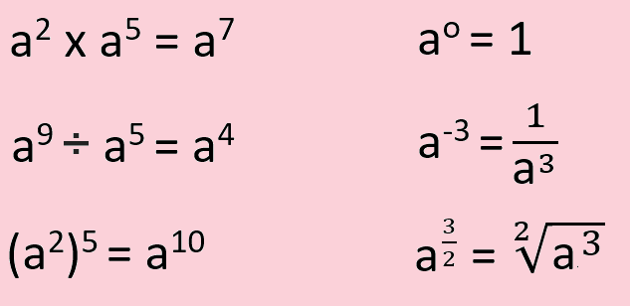
KEY VOCAB
Significant Figures
Integers are whole numbers that can be positive, negative or zero.
Multiples are just times tables. Multiples of 5 are 5, 10, 15, 20, 25 …
Factors is a number that divides into another number exactly and without leaving a remainder. Factors of 10 are 1, 2, 5 and 10.
Index notation is a way of representing repeated multiplications of the same number. For example 5² x 6³ is index notation which also means 5 x 5 x 6 x 6 x 6.
Write 72 as a product of its primes
Square Numbers
Cube Numbers
Hint: Try to find two factors where one of them is prime!
KEY KNOWLEDGE
Standard Form
MATHS
Number
Standard Form is a system of writing numbers which can be particularly useful for working with very large or very small numbers. It is based on using powers of 10 to express how big or small a number is.
Lowest Common Multiple (LCM) is the first number in the times tables of two or more numbers.
3’s: 3, 6, 9, 12, 15, 18, 21, 24
7’s: 7, 14, 21, 28, 35
LCM of 3 and 7 = 21
Highest Common Factor (HCF) is the biggest factor that divides into two or more numbers.
30 12
1 x 30 1 x 12
2 x 15 2 x 6
3 x 10 3 x 4
5 x 6
HCF of 30 and 12 = 6
Laws of Indices
FURTHER READING
https://www.bbc.co.uk/bitesize/topics/z7kw2hv
https://corbettmaths.com/contents/
https://www.pearsonactivelearn.com/app/library

