Slide 1
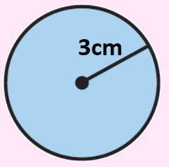
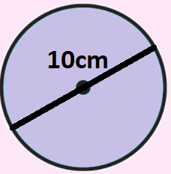
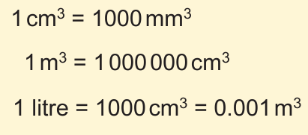
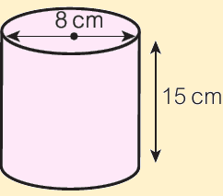
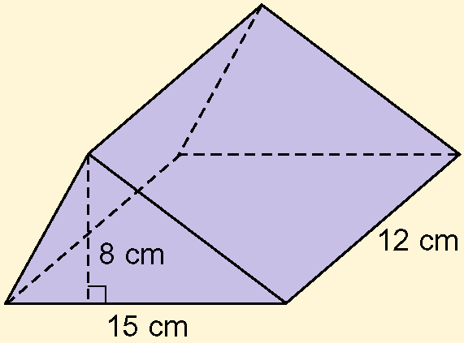

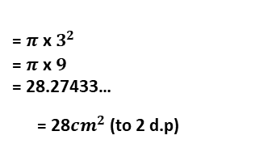
KEY VOCAB
KEY KNOWLEDGE
Perimeter is the distance measured around a 2D shape. You add to reach your answer.
Area is the space measured inside a 2D shape. You multiply to reach your answer.
Volume is the space measured inside a 3D shape.
Radius is the length of a circle from the centre to its edge.
Diameter is the length of a circle from one side to another that goes through the centre.
Circumference is the distance around the outside (perimeter) of a circle.
Area of a circle Circumference of a circle
$$=π {\text{x} radius}^{2}$$
$$=π {\text{x} diameter}^{}$$
Conversions
MATHS
Y9 Area,
Perimeter & Volume
= $π {\text{x} 3}^{2}$
= $π {\text{x} 9}^{}$
= 28.27433…
= 28${cm}^{2}$ (to 2 d.p)
= $π {\text{x} 10}^{}$
= 31.4159265…
= 31cm (to 2 d.p)
Volume of a cylinder
Careful!
When asked to find the surface area of a triangular prism
like this one, you
may need to use
Pythagoras’
theorem to
get all of the
lengths!
Upper and Lower Bounds
“State the upper and lower bounds for 5cm”
Area of the
cross section
x
Height
The lower bound is the smallest possible value that rounds up to the number. Therefore the lower bound is 4.5cm.
The upper bound is the largest possible value that rounds down to the number. Therefore the upper bound is 5.5cm.
Surface area of a cuboid
This can also be shown as an inequality…
FURTHER READING
https://www.bbc.co.uk/bitesize/topics/zrf3cdm
https://corbettmaths.com/contents/
https://www.pearsonactivelearn.com/app/library

