Slide 1
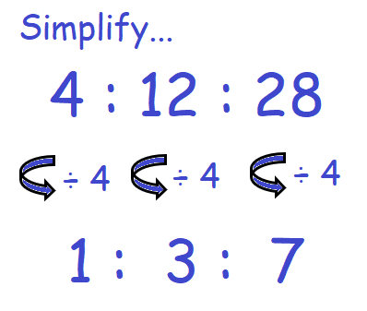
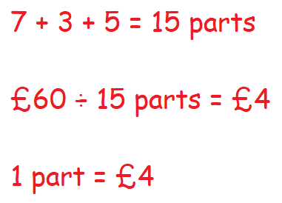
KEY VOCAB
KEY KNOWLEDGE
Ratio shows how much of one quantity there is of something compared to another.
They are usually written in the form a:b. The order in which a ratio is stated is important.
Equivalent ratios have the same value even though they may look different, e.g. 50:100 and 1:2.
Proportion is when two or more quantities have the same relative size.
Unitary means the value of a single unit. Think of other words that begin with ‘uni’ meaning ‘one’ such as unicycle, unison, uniform etc.
Directly Proportional is when one amount increases, another amount increases at the same rate. This can be written as: y = kx where k is the constant of proportionality.
Example: y is directly proportional to x,
when x = 3 then y = 15. What is the constant of proportionality (k)?
Answer (do this after your lesson):
Inversely Proportional is when one value decreases at the same rate that the other increases. This can be written as:
y = $\frac{k}{x}$ where k is the constant of proportionality.
Example: y is indirectly proportional to x,
when x = 4 and y = 3.
What is the constant of proportionality (k)?
Answer (do this after your lesson):
Simplifying Ratios
MATHS
Y9 Ratio &
Proportion
Step 1
Step 2
FURTHER READING
https://www.bbc.co.uk/bitesize/topics/zxw76sg
https://corbettmaths.com/contents/
https://www.pearsonactivelearn.com/app/library
Frank, Mary and Seth shared some sweets in the ratio 4 : 5 : 7 Seth got 18 more sweets than Frank. Work out the total number of sweets they shared.

