Slide 1
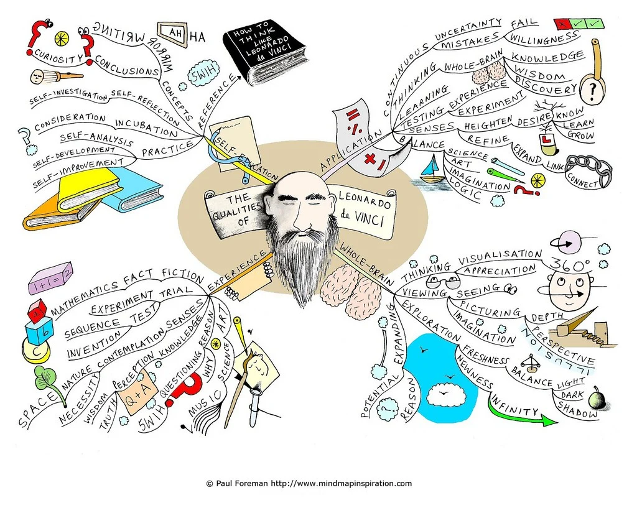
Drama Department
Year 9 – ‘Surrealism and Physical Theatre’
Understanding Dali and his Art
Understanding Artaud
Lesson 1: You Do: Response to Dali’s paintings.
Challenge: Who is Artaud? What was he famous for? What did his audiences’ think of his theatre? Read!!
Reading and Retention
Homework Lesson 1: Can learn the definitions and spellings of the highlighted words.
1.
2.
3.
4.
5
https://www.bl.uk/20th-century-literature/articles/antonin-artaud-and-the-theatre-of-cruelty
Lesson 1: Do Now: (Change) Create a mind map to make a definition of Surrealism.
Unit of Work Key Vocabulary word bank​
Surrealism | Nonsense | ​Sound Collage
Artaud | Spain | Genre
Dali | Exaggeration ​ | Creativity
Abstract | Shapes | Projection ​
Tone | Continuity | Rehearse​
Unrealistic | Concentration | Improvisation
​Inflection | Formations | Bizarre
Tone | Dynamics | Realism
Life Lessons | Ensemble | Unconventional
Proxemics | Imagination | Senses
Puppeteering | Body Lang | Dramatic
Lesson 4: Do Now (Change): Draw your own surreal Image.

