Slide 1
Year 9 Options 2024
Welcome!
The aim of this presentation is to clarify the options process, the types of qualifications offered and some of the terminology involved.

Slide 2
Year 9 Options
Compulsory Subjects
Subject | Qualification
English Language and Literature | GCSE (2 certificates)
Science (Trilogy or Separate) | GCSE (2 or 3 certificates)
Mathematics | GCSE (1 certificate)
Physical Education | None
Compulsory subjects account for 3/5 of the curriculum (16 lessons)
The remaining 9 lessons are for Option Subjects
(3 choices for 3 hours a week in Year 10 and 2 hours a week in Year 11)

Slide 3
E-Bacc or not?
The E-Bacc (English Baccalaureate) is a recognition of a good pass at GCSE, which means gaining a grade 5 or higher in the following subjects:
English (Language and Literature) (Compulsory)
Maths (Compulsory)
Science (Trilogy or Separate) (Compulsory)
A Language (Spanish) (Optional)
History or Geography (Optional)
What does it mean?

Slide 4
We know that:
It is not an “extra” qualification, just a recognition of grade “5” or better in all those subjects
No local FE colleges or 6th forms require it for entry to their courses
No HE universities state it in their entry requirements (see Russell Group “Informed Choices” document)
Our advice therefore is to pick the subjects which give you the best chance of the best grades

Slide 5
The Russell Group
This is the following group of Universities:
University of Birmingham | University of Bristol | University of Cambridge | Cardiff University | Durham University
University of Edinburgh | University of Exeter | University of Glasgow | Imperial College London | King's College London
University of Leeds | University of Liverpool | London School of Economics & Political Science | University of Manchester | Newcastle University
University of Nottingham | University of Oxford | Queen Mary, University of London | Queen's University Belfast | University of Sheffield
University of Southampton | University College London | University of Warwick | University of York

Slide 6
What can students choose?
We aim to meet as many student choices as possible by building the timetable around their choices:
Box A - Choose any 2 |  |  | Box B - Choose 1
GCSE Choices¹: |  | Vocational Choices²: | GCSE Choices¹:
Art: Art & Design | Geography³ | Vocational IT | Computer Science
Art: Photography | GCSE PE (Boys) | Level 2 Award in Construction | Geography³
Art: Textiles | GCSE PE (Girls) | Child Development and Care | History³
Business Studies | History³ | Sport Studies (Boys)⁵ | Spanish⁴
Computer Science | Music | Sport Studies (Girls)⁵
Design Technology | Religious Education
Drama | Spanish⁴
Food and Nutrition⁵
Vocational subjects are good choices for some, but not all students, this will be discussed in the options interview. Vocational choices may be restricted. If we feel your child could follow the GCSE route rather than the equivalent route and there is no space in the group, we may need to speak to you again.
At the beginning of Year 10 students will start their studies in science. Throughout the course their progress is carefully monitored to ensure they are gaining the necessary disciplinary and procedural knowledge. This data is then used to determine whether students are entered for the Trilogy Science or Separate Science GCSEs.

Slide 7
Ineligible Combinations
There are certain combinations of subjects that the exam boards will not allow as the courses are considered to be too similar. If you are thinking about choosing any of the subjects highlighted in red, please take note of the points below.
Box A - Choose any 2 |  |  | Box B - Choose 1
GCSE Choices¹: |  | Vocational Choices²: | GCSE Choices¹:
Art: Art & Design | Geography³ | Vocational IT | Computer Science
Art: Photography | GCSE PE (Boys) | Level 2 Award in Construction | Geography³
Art: Textiles | GCSE PE (Girls) | Child Development and Care | History³
Business Studies | History³ | Sport Studies (Boys)⁵ | Spanish⁴
Computer Science | Music | Sport Studies (Girls)⁵
Design Technology | Religious Education
Drama | Spanish⁴
Food and Nutrition⁵
Students may opt for Art: Textiles and Photography, or Art and Photography. But NOT Art and Art: Textiles.
Sport Studies and PE cannot be chosen together
We advise against picking subjects that are similar, e.g. DT and Construction

Slide 8
Grade 9 to Grade 1 GCSEs
As a guide the numbers are broadly equal to the old grades shown below:
‘Standard’ GCSE Pass
‘Strong’ GCSE Pass
New Numbers | 1 | 2 | 3 | 4 | 5 | 6 | 7 | 8 | 9
Old Grades | G/F- | F/E | E+/D | C | C+/B- | B/B+ | A | A* | A**
This system affects all GCSE subjects.
There are, however, a number of vocational subjects that are graded differently:
‘Standard’ GCSE Pass
‘Strong’ GCSE Pass
 | Level 1 |  |  | Level 2
Grade | Pass | Merit | Distinction | Pass | Merit | Distinction | Distinction*
GCSE Equivalent | 1 | 2 | 3 | 4 | 5/6 | 7 | 8

Slide 9
Science: Trilogy vs Separate
Both courses include the study of Biology, Physics and Chemistry
Separate Sciences (Triple)
Trilogy Award Science (Double)
Triple Knowledge
Triple Knowledge
Triple Knowledge
Trilogy Knowledge
Trilogy Knowledge
Trilogy Knowledge
Biology
Chemistry
Physics

Slide 10
Vocational Qualifications
These are equivalent GCSE courses and are awarded the following grades:
Grade | L2 Distinction* | L2 Distinction | L2 Merit | L2 Pass | L1 Distinction | L1 Merit | L1 Pass
Equivalent to | 8 | 7 | 5/6 | 4 | 3 | 2 | 1
Vocational Award in ICT
Child Care
Construction
Sport Studies
It may not be possible to give you your vocational choice. If you want to follow a vocational option you will also need to choose a backup GCSE option

Slide 11
Advice for Students
Choose subjects they are likely to do best in. Use the information from reports and the feedback from teachers as guidance
Don’t make a choice just because they like the teacher. That teacher may well not be taking the group students end up in
Be realistic about strengths and weaknesses and accept advice about the type of courses on offer.
Complete research by reading the options booklet thoroughly and talking to teachers
Above all don’t choose a subject because friends are doing it! There is no guarantee they will end up in the same class!

Slide 12
Guidance
We can guide student to courses which we know will offer the very best chances of achieving the best grades.
Vocational options offer the best progression routes for some students. However, they are less suitable for others.
The options interview will be an opportunity to discuss the best combination of subjects for your child to get the best possible outcomes.

Slide 13
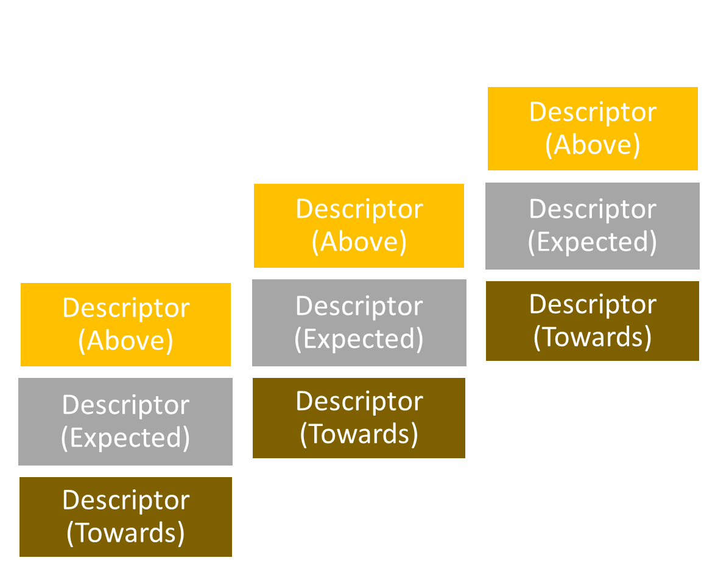
Making informed choices based on KS3 performance
As current Y9 students do not have any SATS data due to cancellation of these we have based starting points on CAT reading tests.
Gained a SATS score of 110+ in Y6
Access to GCSE grades 7, 8, 9
Gained a SATS score of 100-109 in Y6
Access to GCSE grades 4, 5, 6+
Access to GCSE grades 1, 2, 3+
Gained a SATS score below 100 in Y6
Our KS3 curriculum is not capped. Once a student masters a skill they consolidate it and move on to another. If a student works hard they can make faster progress and improve their chances of a better GCSE grade.

Slide 14
Key Stage 4 Timetable
Different bands – H & W
All students will be re-banded
Current X band does not equal H; current Y band does not equal W
Both bands will have foundation and higher tier entries for Maths and Science. These are not ability bands
All year group on options at the same time

Slide 15
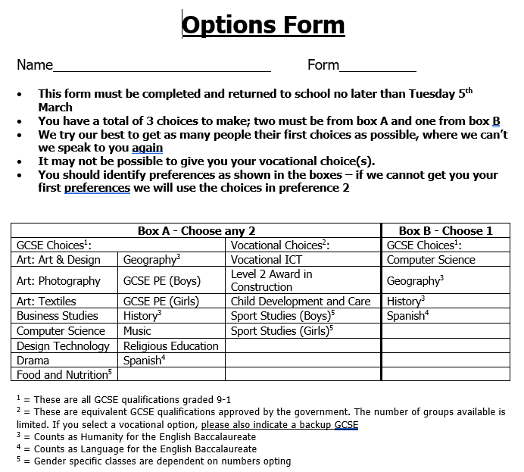
Options Form
You will find the options form at the back of the options booklet
Students need to make three choices from the subject list – two set of preferences
There are four vocational subjects that are available. If any vocational choice is made a GCSE back-up is also required
Any two choices can be made from Box A and one choice from Box B (please bear in mind the combinations that cannot be chosen from earlier in this presentation)
Deadline is Tuesday 5th March

Slide 16
Options Interviews
Every student will have an option interview with their parents(s) and a member of the Senior Team
We will have slots available during the day and into early evening
Appointments will be available on Tuesday 13th and Thursday 29th February 3.30-7.30 pm
Appointments can be made at the options evening
The deadline for completion and return of the options form is Tuesday 5th March

Slide 17
Support
Guidance from staff at virtual Parents Evening
Options interviews
School Website:
- Option booklet
- Russell Group “Informed Choices”
- BBC Bitesize Option Support
- Subject Choices at Year 10 link from the Government of Northern Ireland
- Useful links to Careers websites
- This presentation

Slide 18
Support: Hawkley Website
Includes:
This presentation
A pdf version of the options booklet
Options form
Careers Service subject choice advice
Links to other useful websites
School website: School Life> Year 9 Options

Slide 19
Support: Informed Choices
Allows you choose which A Level course you are interested in
Then points you towards degrees that your A Level choices could lead to and Universities that offer these
Useful as it will help you make you option choices if you know what you want to do in the future
www.informedchoices.ac.uk

Slide 20
Support: BBC Bitesize
Includes a short video and some frequently asked questions about options, including:
Which GCSEs should I take?
How many GCSEs should I take?
Which GCSE options are compulsory?
What GCSE options are there?
Can I change my GCSE subjects?
When do I have to pick my GCSE subjects?
https://www.bbc.co.uk/bitesize/articles/zrjh92p

Slide 21
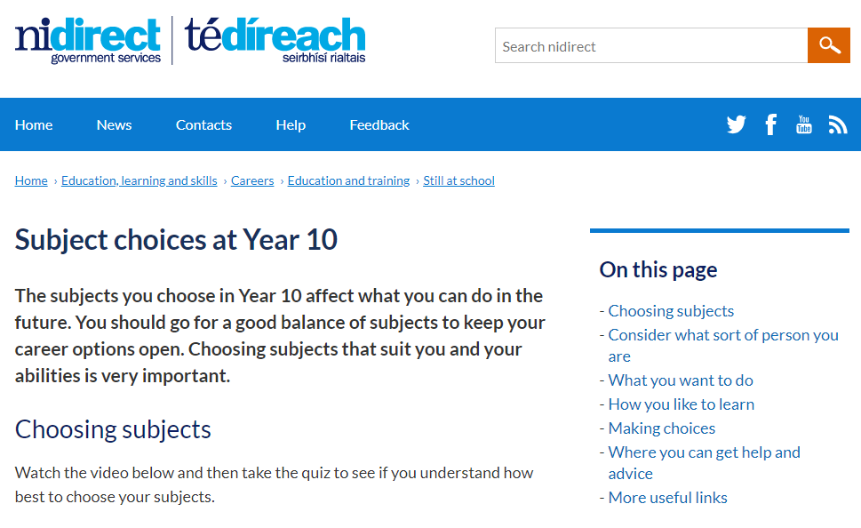
Support: Advice from Government of NI
From the government of Northern Ireland, but does include some useful guidance and advice for helping students to make their choices
https://www.nidirect.gov.uk/articles/subject-choices-year-10

Slide 22
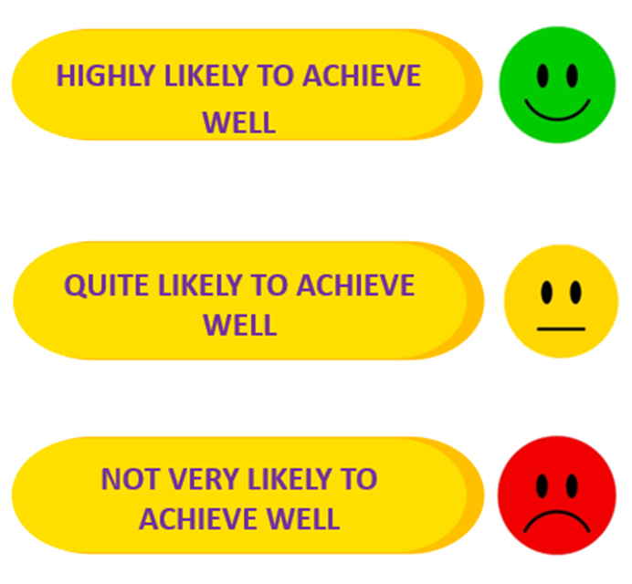
Attendance Matters
Research shows that attendance at school has an impact on students’ chances of achieving five good GCSE Grades:
If attendance is 95.1% to 100%...
If attendance is 90.1% to 95%...
If attendance is 85.1% to 90%...

Slide 23
Attendance Matters
Five or more GCSE grades at grade 4 or above can increase potential wages by 41%
Nationally students with 91% attendance or less will drop at least ONE GCSE grade
Now think about this!
Taking just 10 days holiday in term time means that your MAXIMUM attendance can only be 95%
And this!
Taking a day off every couple of weeks means that your MAXIMUM attendance can only be 90%

Slide 24
Key Dates
Tuesday 13th and Thursday 29th February– options interviews take place
Options form deadline Tuesday 5th March
Wednesday 6th March onwards – groups are generated and the school timetable is produced:
The vast majority of students will study their initial choices
It is likely that a small number (6 in 2016, 5 in 2017, 6 in 2018, 6 in 2019; 3 in 2020) will have to be interviewed again and choose a different combination due to timetable clashes. Families and students will be contacted if this is the case

Slide 25
Key Contact Information
The most efficient method of communication for questions or to request an options interview is via email to:
year9options@hhhs.net

